Slide 1
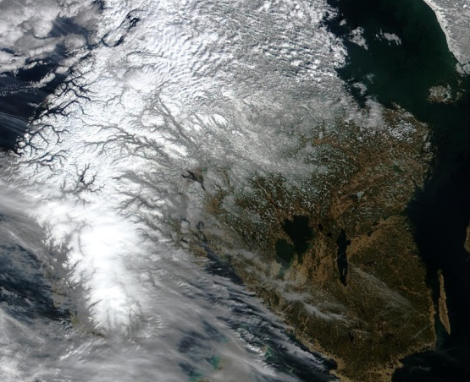
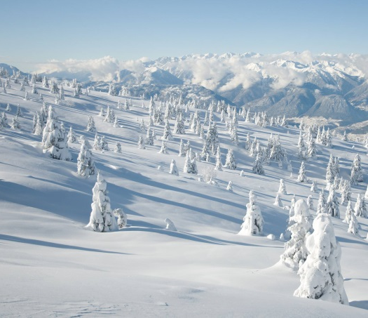
Remote sensing of snow properties with Sentinel-3 versus MODIS
Rune Solberg, Øivind Due Trier, Øystein Rudjord
Section for Earth Observation
Norwegian Computing Center
9th EARSeL workshop on Land Ice and Snow
3 - 5 February 2020, Bern, Switzerland

Slide 2
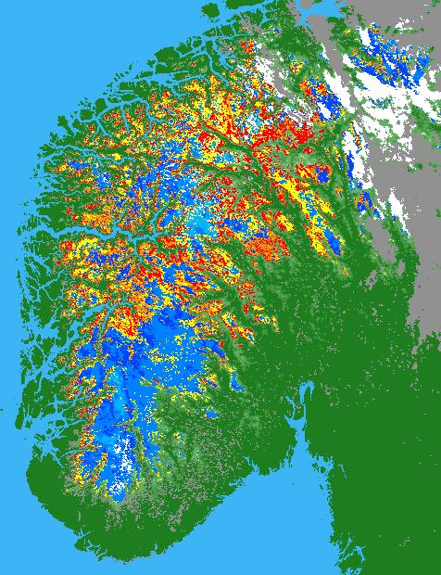
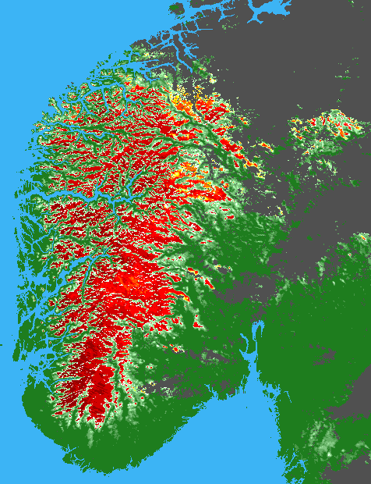
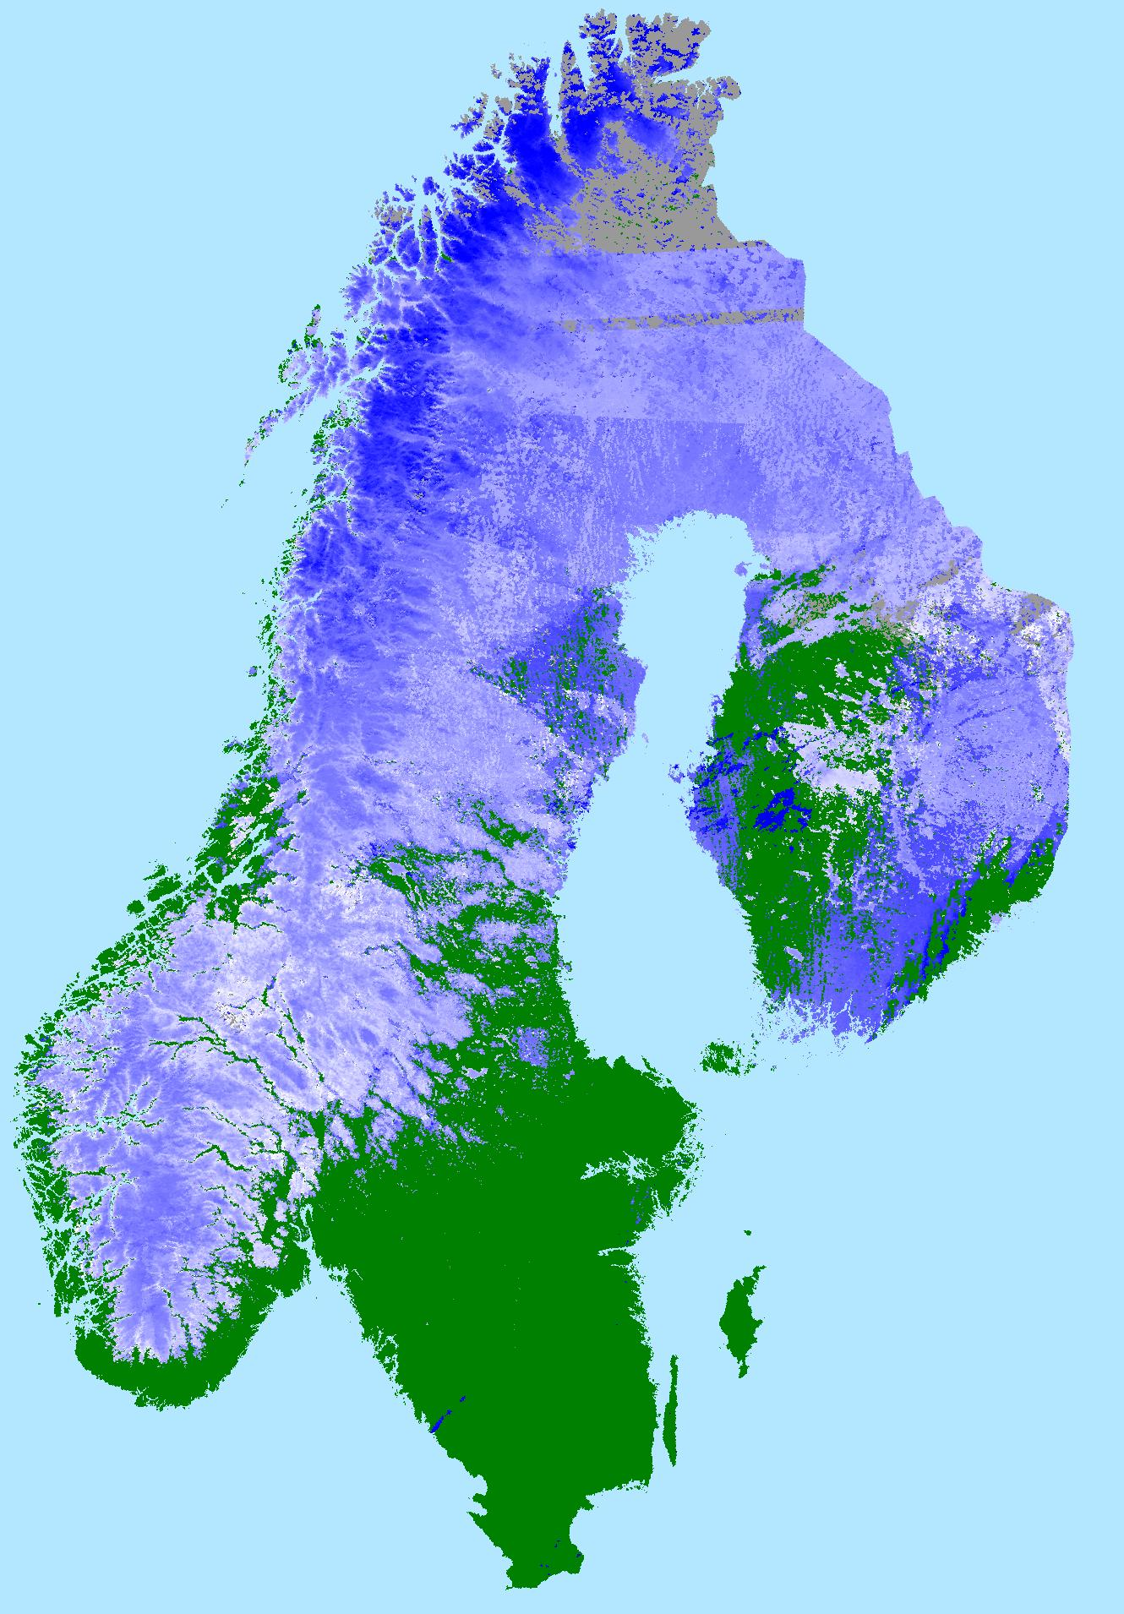
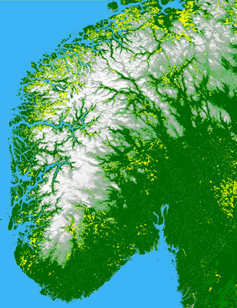
Snow product portfolio developed with MODIS data
Snow cover
Snow surface temperature
Snow grain size
Snow surface wetness
Snow surface hoar
Snow spectral albedo
Snow impurities
Black carbon in snow

Slide 3
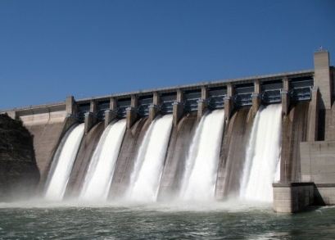
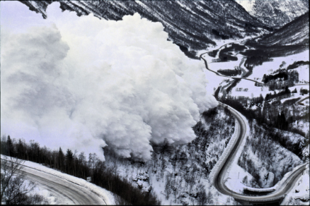
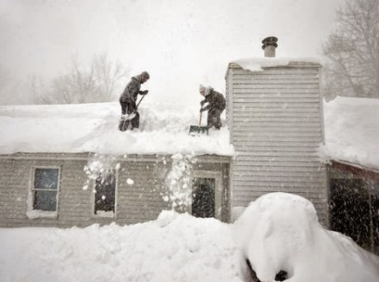
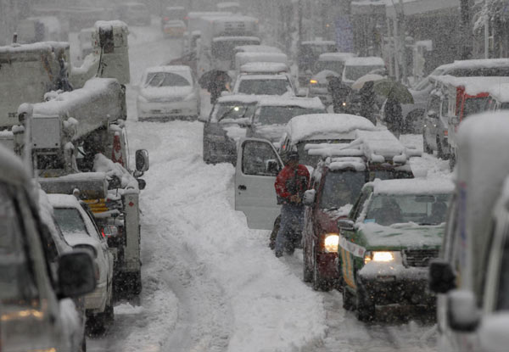
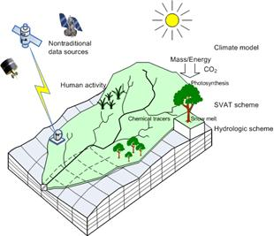
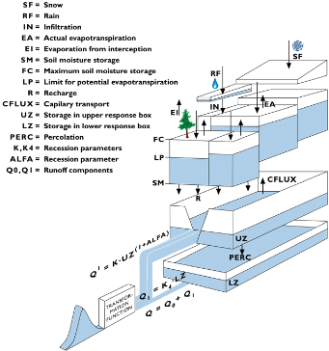
Significant interest in snow in Norway
Impacts
  Water supply
  Hydropower
  Floods
  Avalanches
  Transportation
  Infrastructure
  Buildings
Hydrological modelling
  Model validation and correction
  Model input and assimilation
National snow service development for NVE a significant R&D driver
HBV Model (from HydAlp project)
Distributed model (Q. Tang, T. Oki, and S. Kanae)

Slide 4
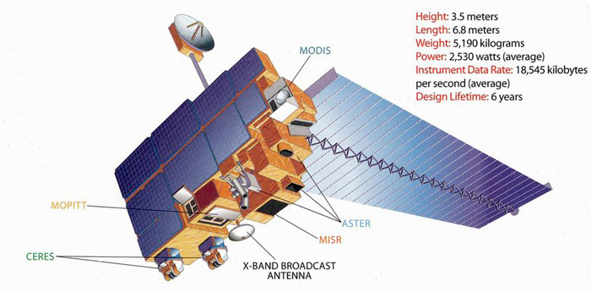
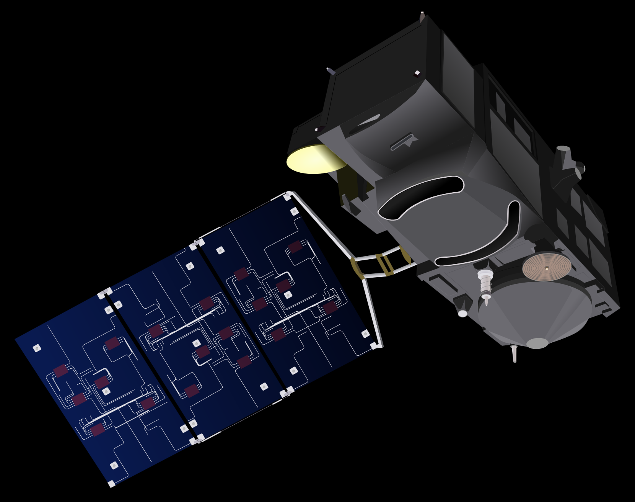
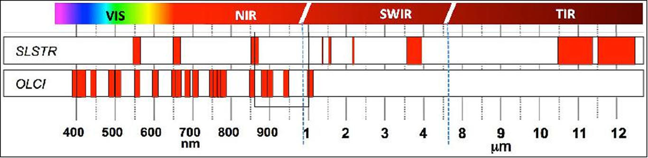
Terra MODIS and Sentinel-3
Moderate Resolution Imaging Spectroradiometer (MODIS)
  Swath width 2330 km
  36 bands
  Spectral range 405–14.385 nm
  Spatial resolution 250-1000 m
Sea and Land Surface Temperature Radiometer (SLSTR)
  Swath width 1675 km
  9 bands
  Spectral range 555–12000 nm
  Spatial resolution 500–1000 m
Sentinel-3A launched 16 February 2016
Sentinel-3B launched 25 April 2018
Terra
NASA
Sentinel-3
ESA

Slide 5
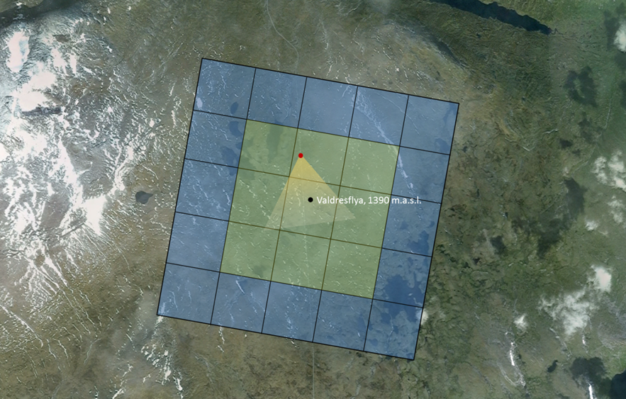
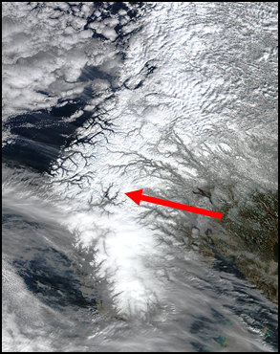
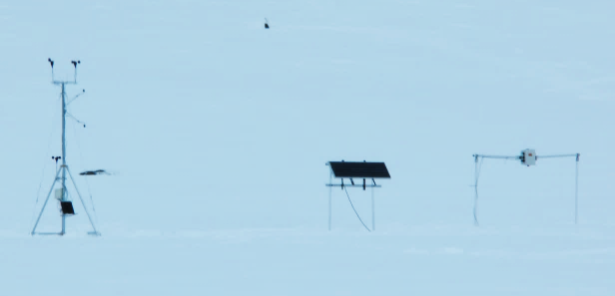
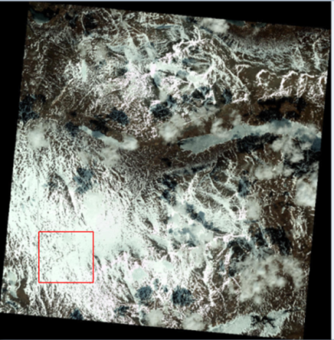
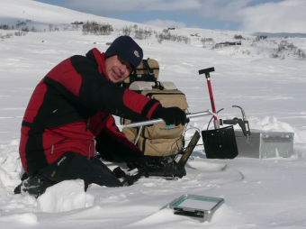
Jotunheimen test site – Bridging the gap in scale between satellite and field measurements
Portable weather station and Spectral Evolution UDS-1100 time-lapse spectrometer
Valdresflya, Jotunheimen, mountain plateau, 1200-1400 m a.s.l., total area 265 km²

Slide 6
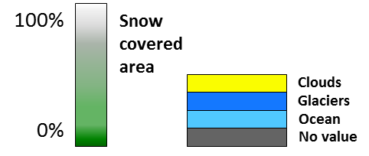
FSC from MODIS and SLSTR by S&A
MODIS
23 February 2017
23 March 2017
1 May 2017
23 May 2017
SLSTR
S&A = Salomonson & Appel algorithm (2004)

Slide 7
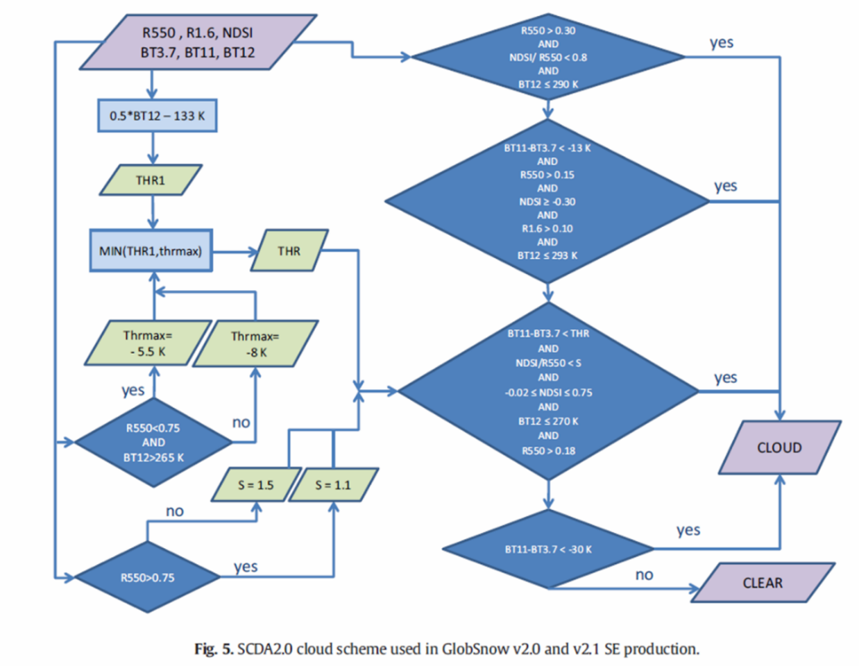
Cloud detection over snow
Simple Cloud Detection Algorithm,
(SCDA) v. 2.0 (Metsämäki et al. 2015)
SLSTR, 30 April 2017

Slide 8
Cloud detection, high winter
S&A, SLSTR
Colour composite, MODIS
S&A, MODIS
Example 1 January 2017, Solar elevation 4-8°

Slide 9
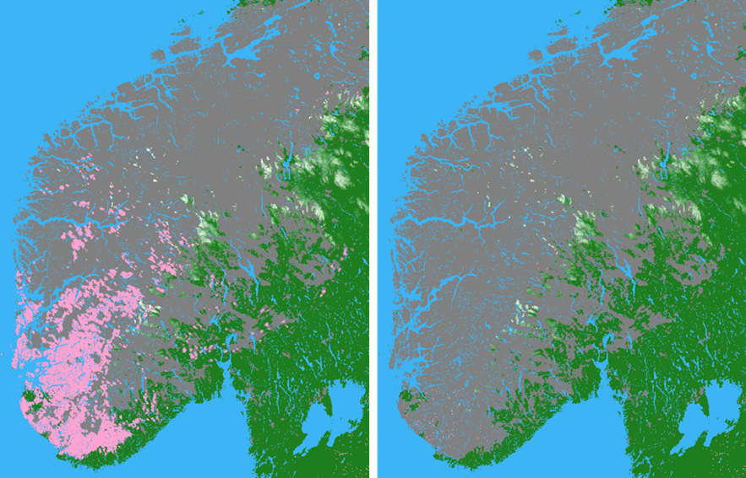
Temperature threshold for S7
FSC from SLSTR 6 May 2018. Left: Standard threshold of 305 K for S7. Right: Same processing, but for S7 without thresholding

Slide 10
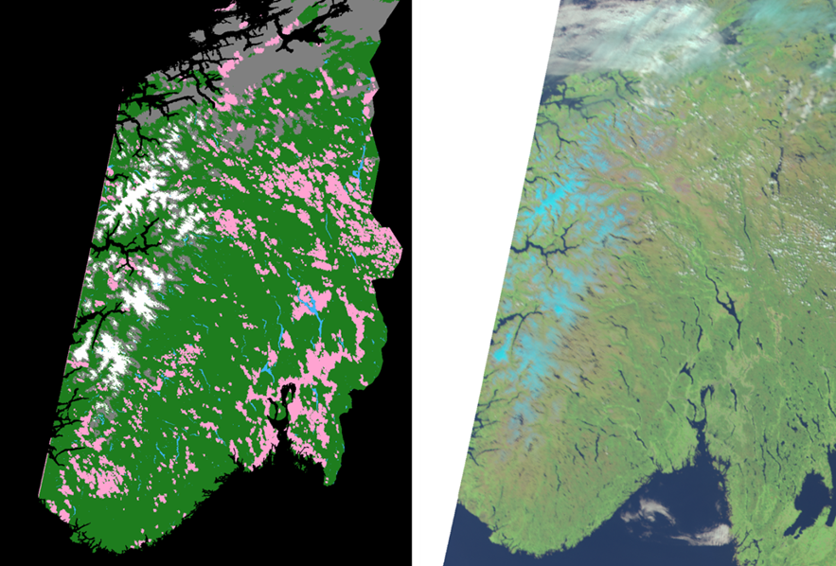
Surface temperatures > 305 K in S7
SLSTR 3 June 2018. High surface temperatures in summer might be above threshold value of 305 K. Agricultural areas would typically have higher surface temperatures than forested areas

Slide 11
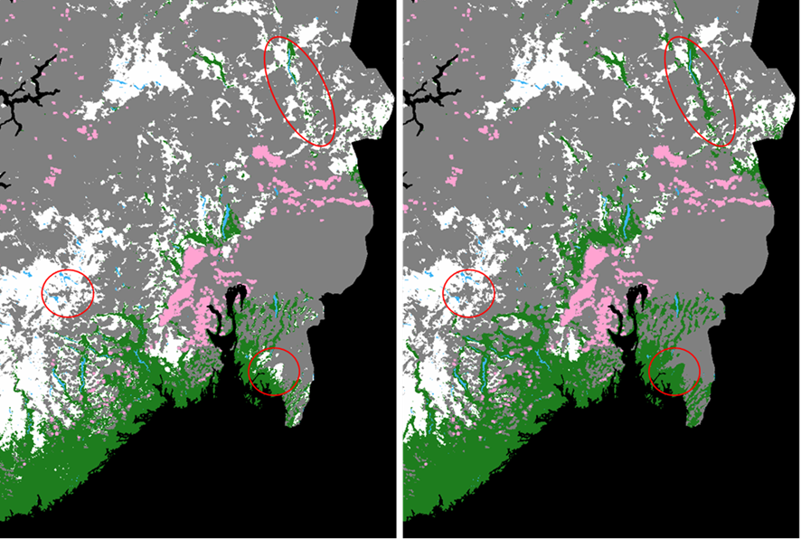
Bias correction of S5 and S6
SCE, SNOMAP, 28 April 2018 without correction of S5 and S6 (left) and with correction (right)

Slide 12
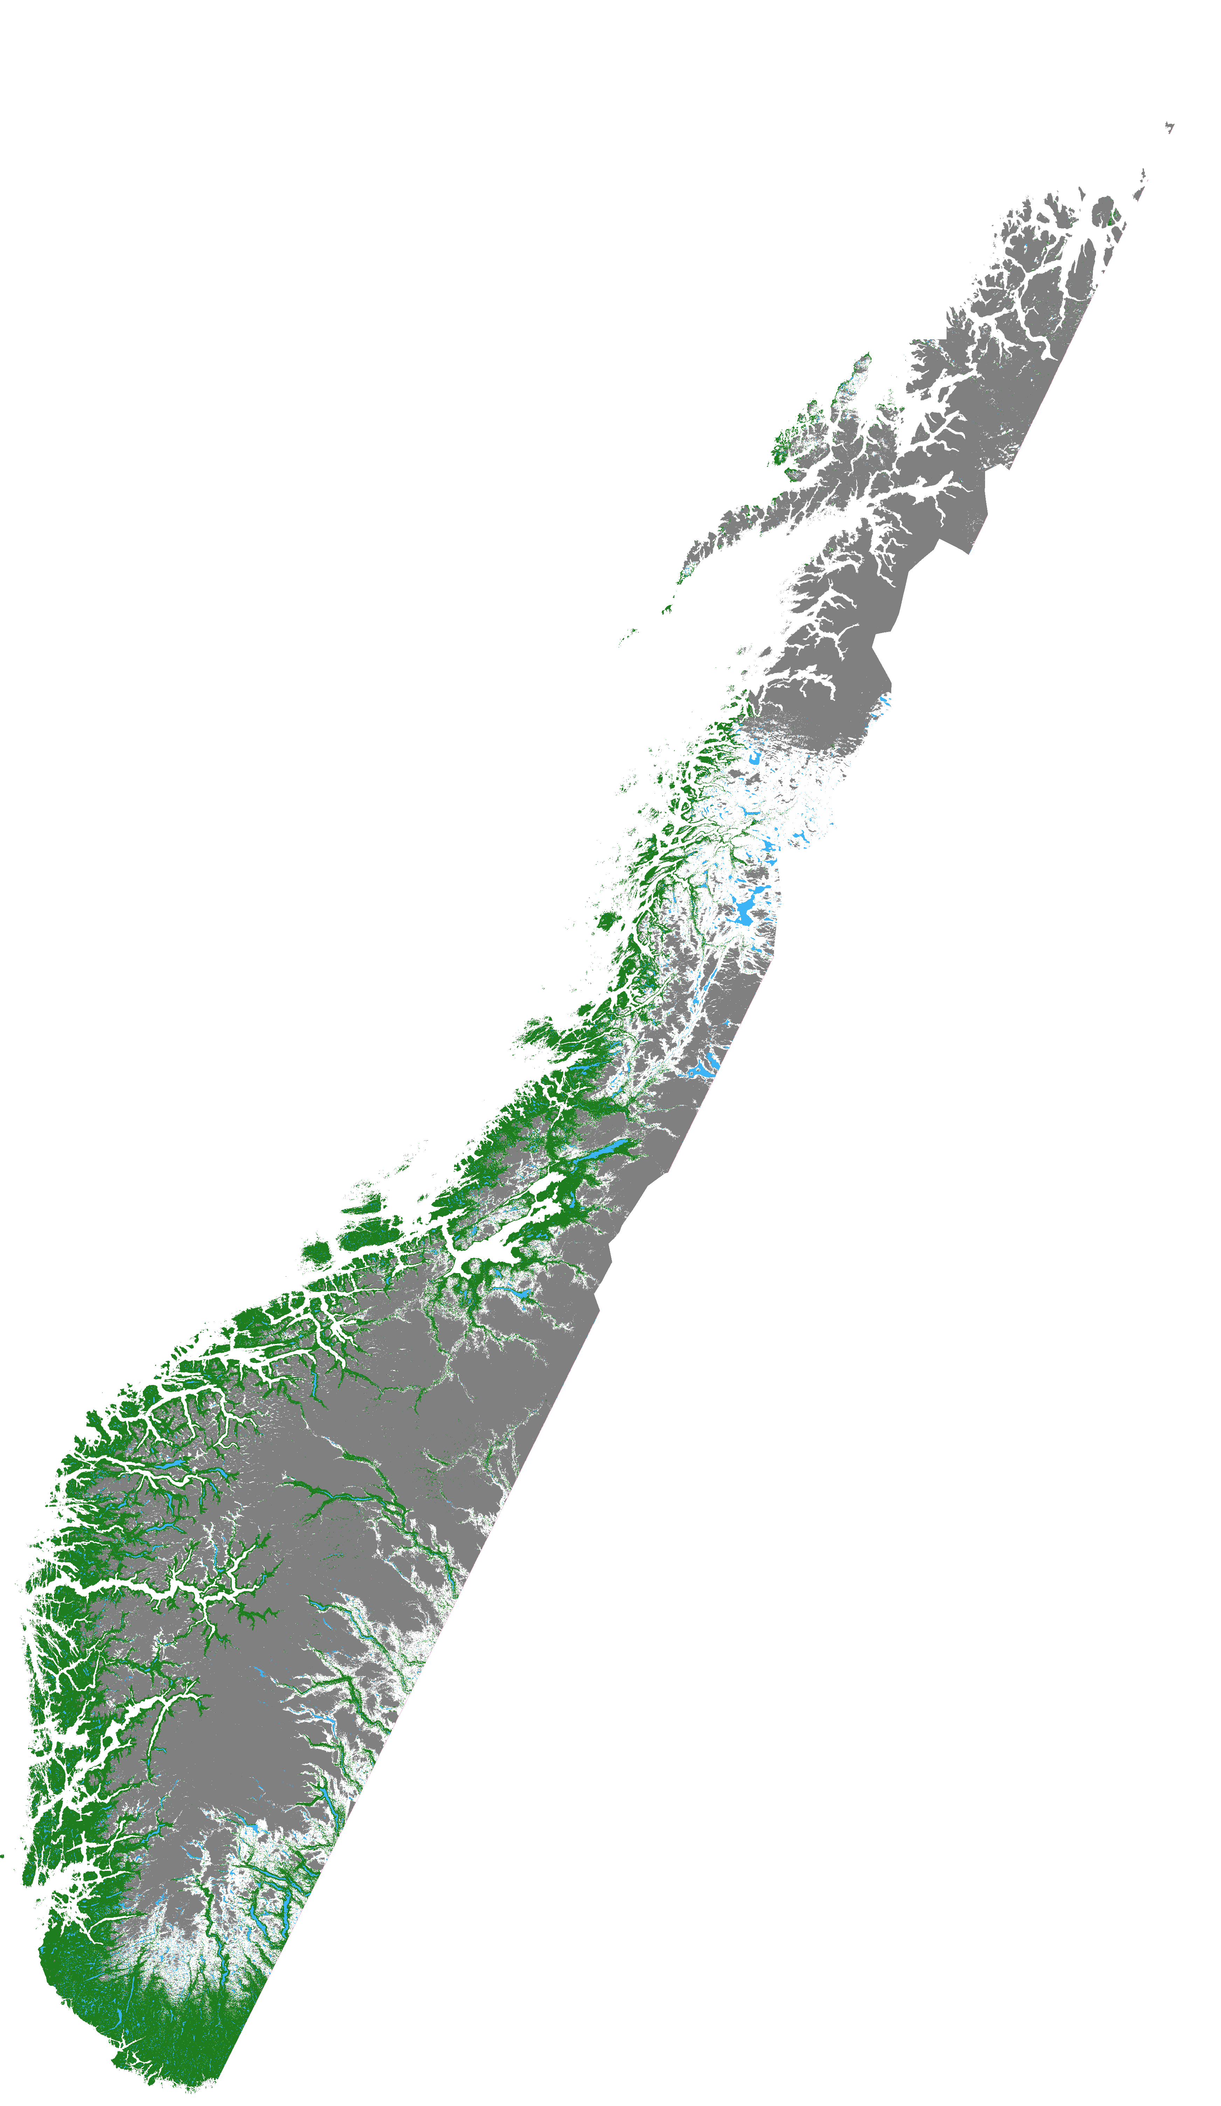
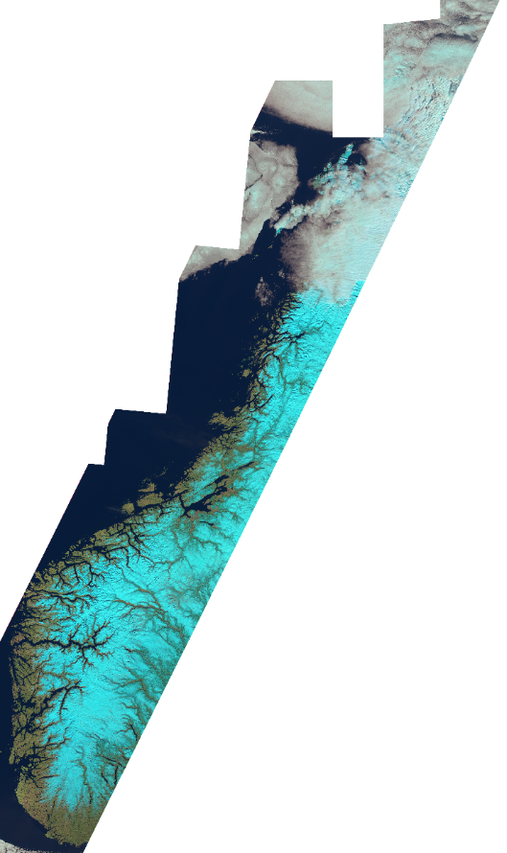
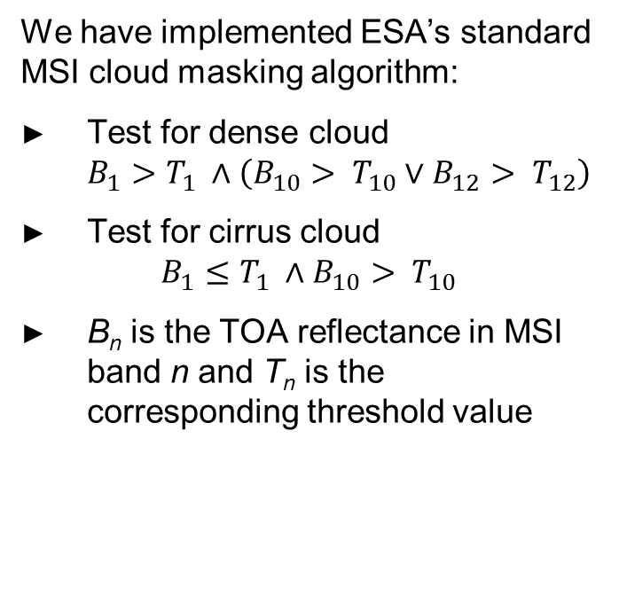
Cloud masking with Sentinel-2
We have implemented ESA’s standard MSI cloud masking algorithm:
Test for dense cloud
$B_{1}>T_{1} ∧\left(B_{10}> T_{10}∨B_{12}> T_{12}\right)$
Test for cirrus cloud
$B_{1}≤T_{1} ∧B_{10}> T_{10}$
B_{n} is the TOA reflectance in MSI band n and T_{n} is the corresponding threshold value
Sentinel-2 SCE, SNOMAP 14 April 2019 and MSI cloud mask
Sentinel-2 colour composite
14 April 2019

Slide 13
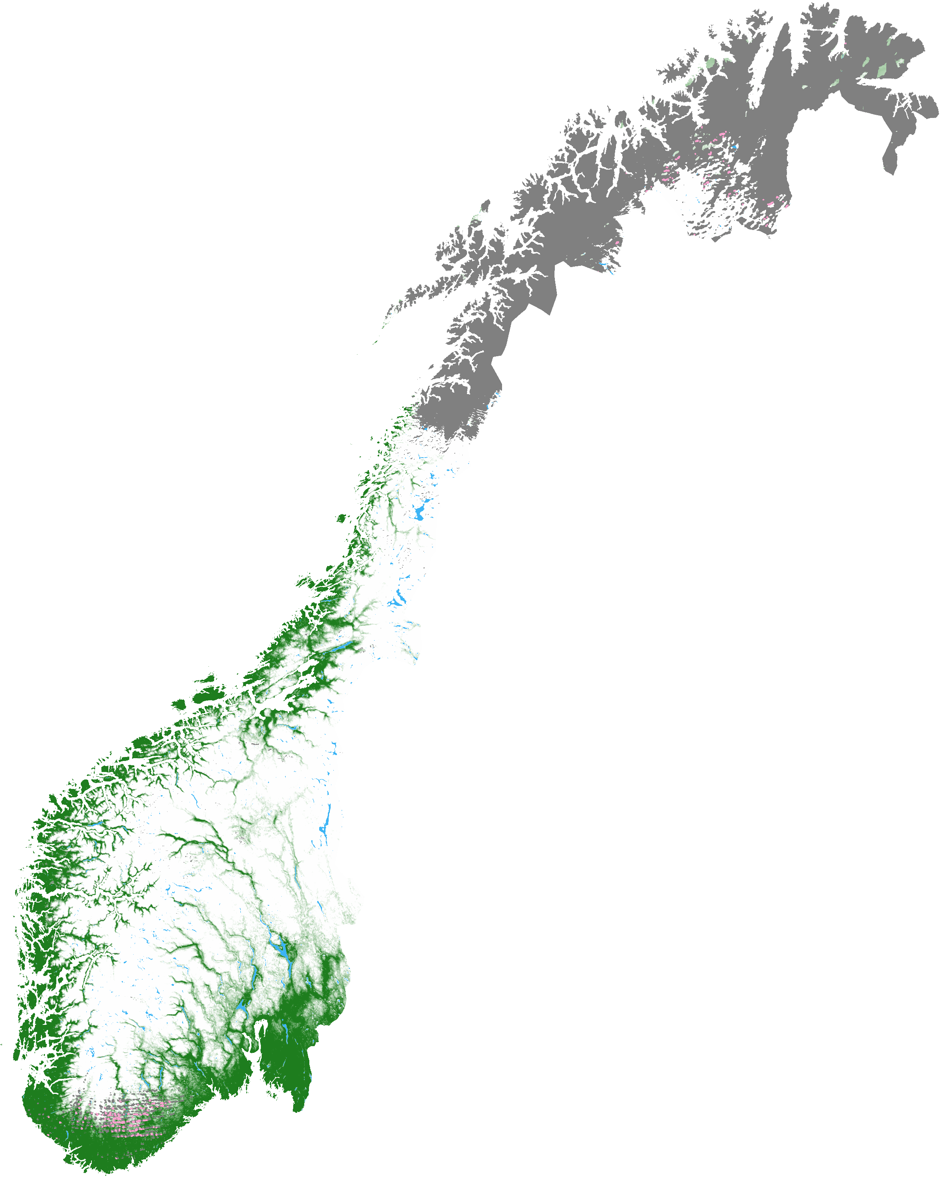
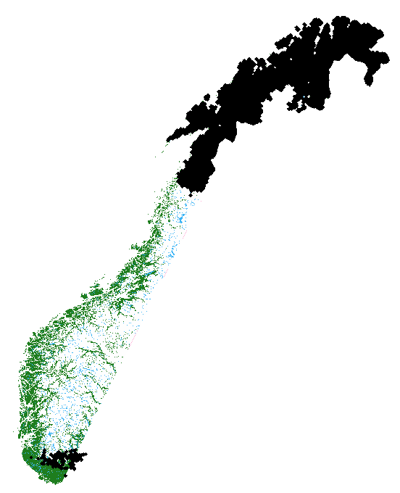
Transfer of cloud mask from
Sentinel-3 to Sentinel-2
Cloud detection with SLSTR
Cloud mask is generalised and expanded to compensate for changes in cloud cover between acquisitions
Sentinel-2 tiles not covered by the cloud mask are chosen for snow
mapping
Cloud mask
generalised
Sentinel-3 FSC S&A, 14 April 2019
Sentinel-2 SCE SNOMAP 14 April 2019

Slide 14
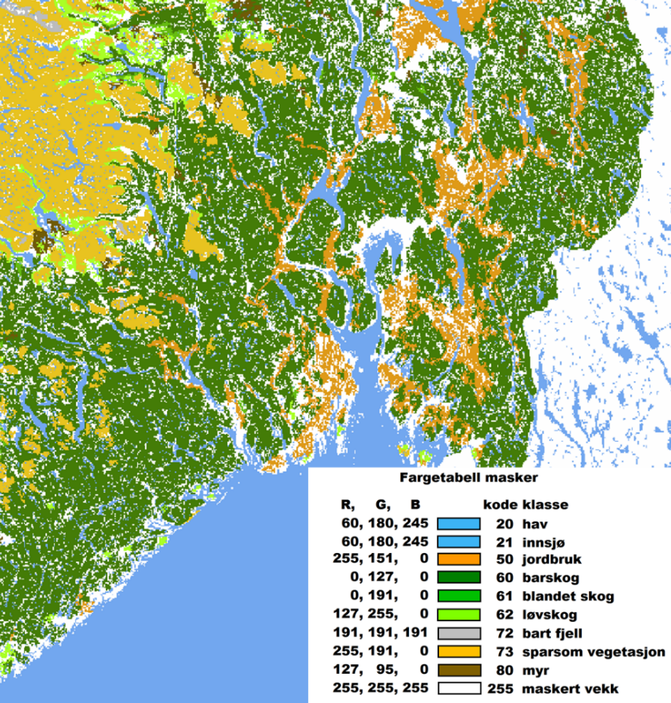
Preliminary validation results for FSC
Stratification in land cover classes differently affecting viewable snow cover
“Ground truth” determined semi-manually from Sentinel-2
Preliminary results includes March-June 2019 S&A FSC only
Land cover class | RMSD (% FSC)
Agriculture | 11.43
Coniferous forest | 24.68
Mixed forest | 18.64
Deciduous forest | 14.17
Vegetation-free mountain | 8.78
Low vegetation | 7.62
Peat | 9.39
All classes | 14.59

Slide 15
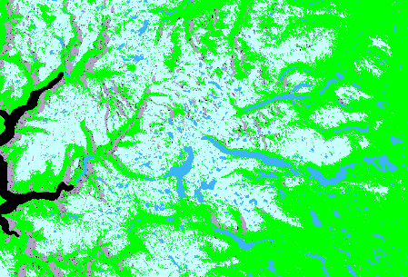
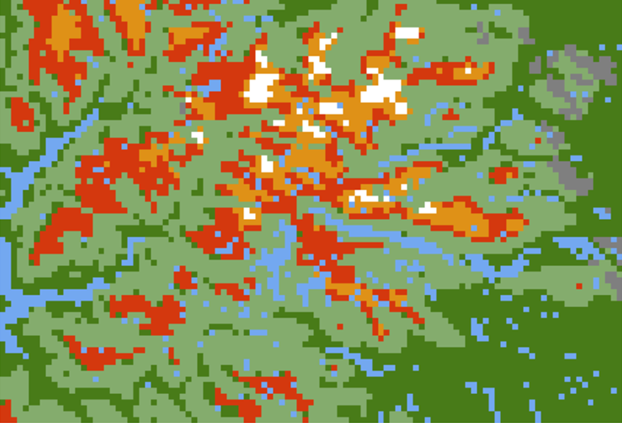
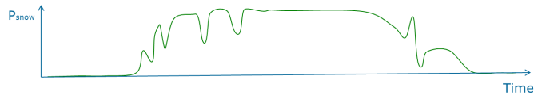
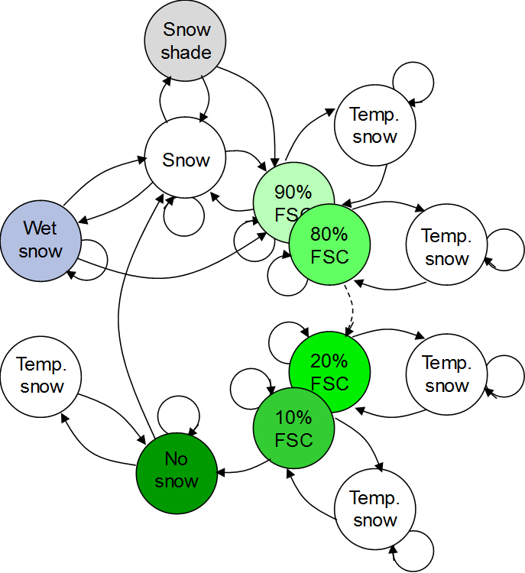
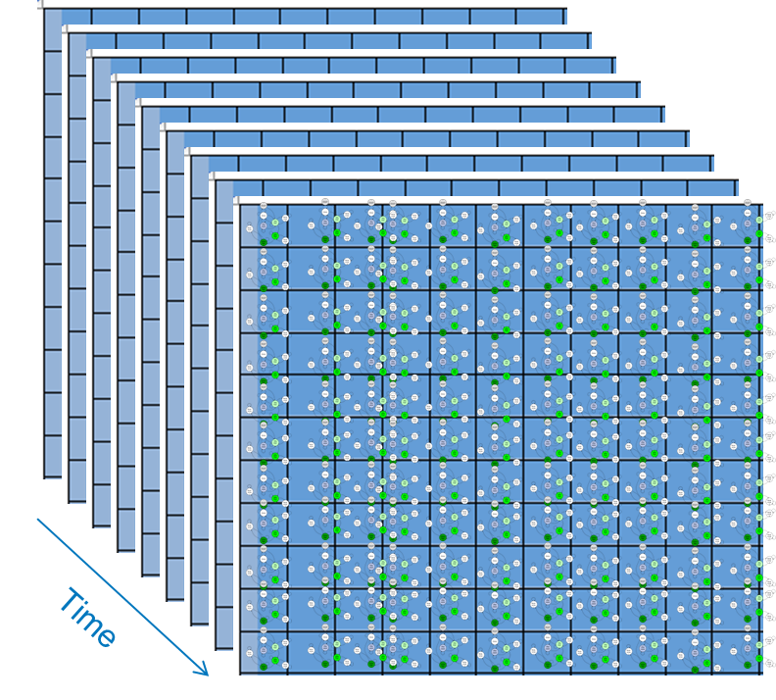
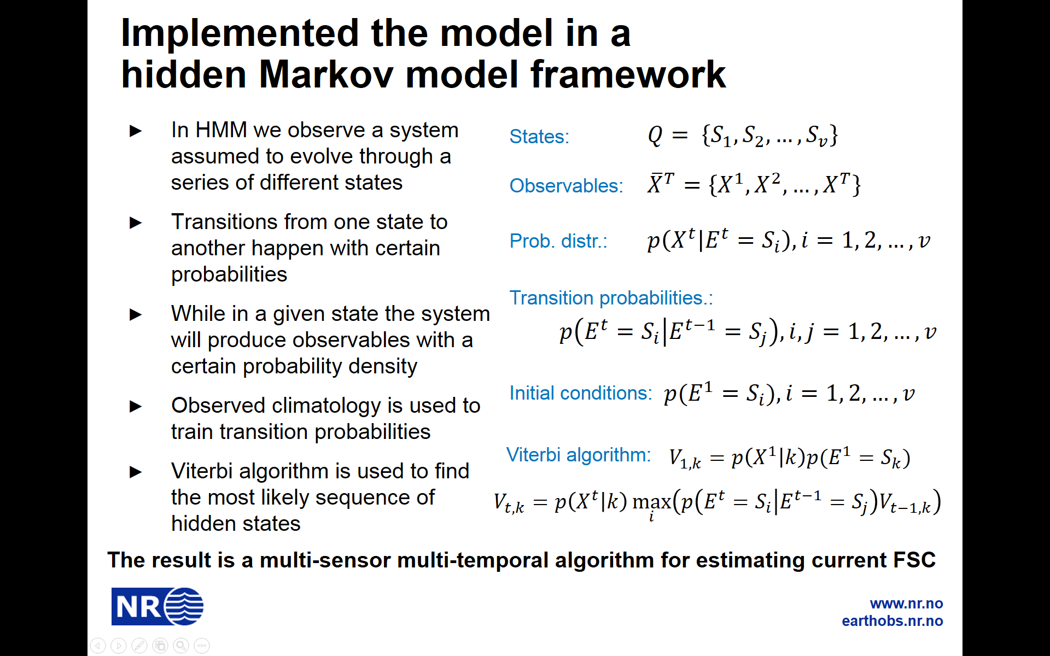
HMM multi-sensor multi-temporal algorithm combining Sentinel-1 and Sentinel-3 data
Sentinel-1 SAR
Sentinel-3 optical (SSW)
Space-time hidden Markov model

Slide 16
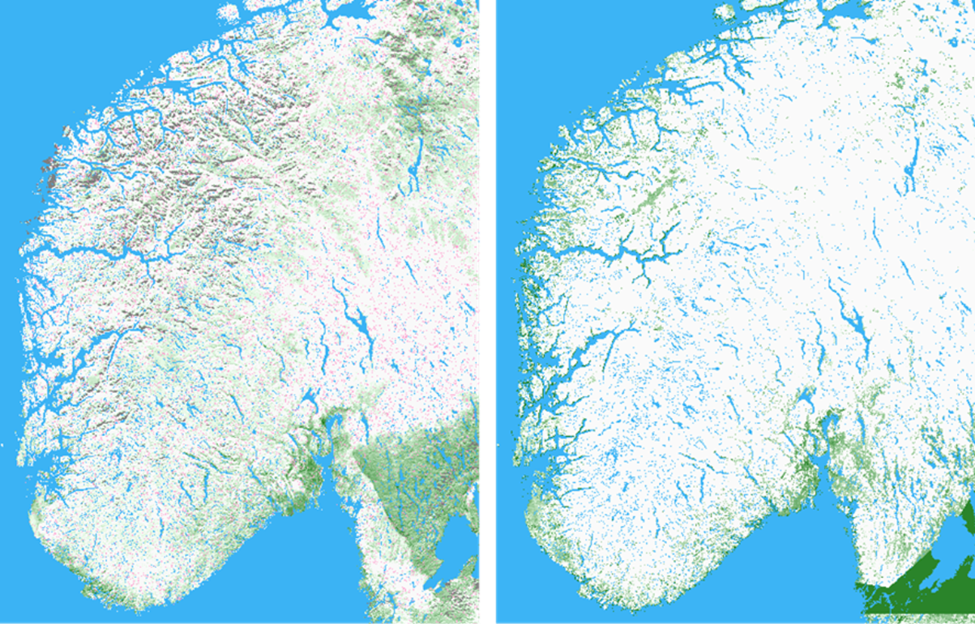
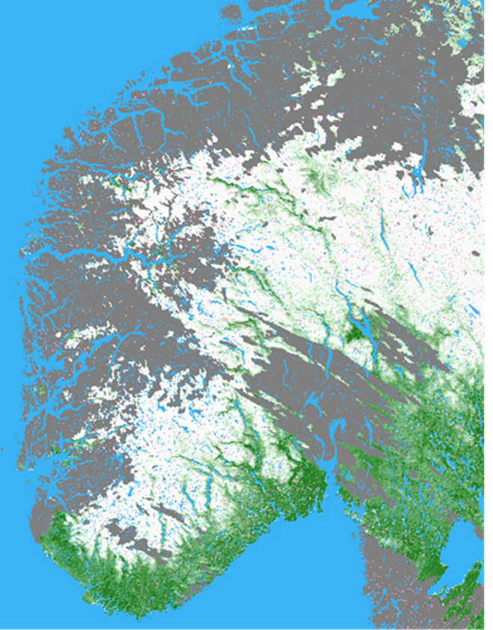
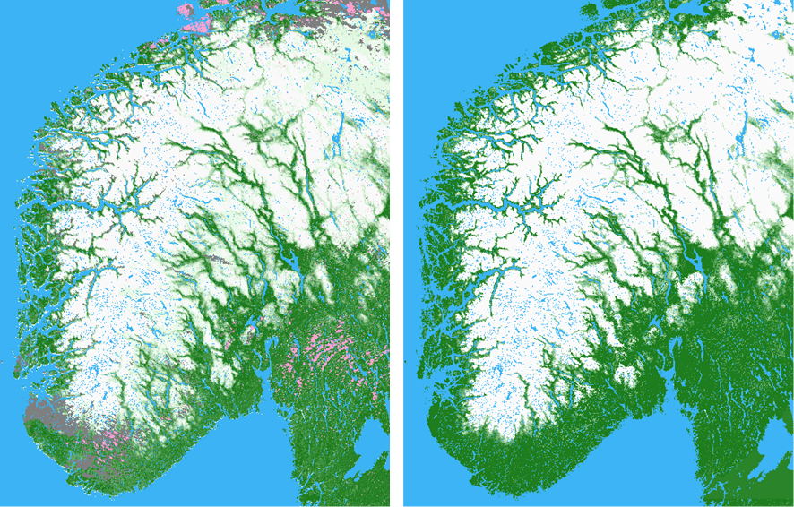
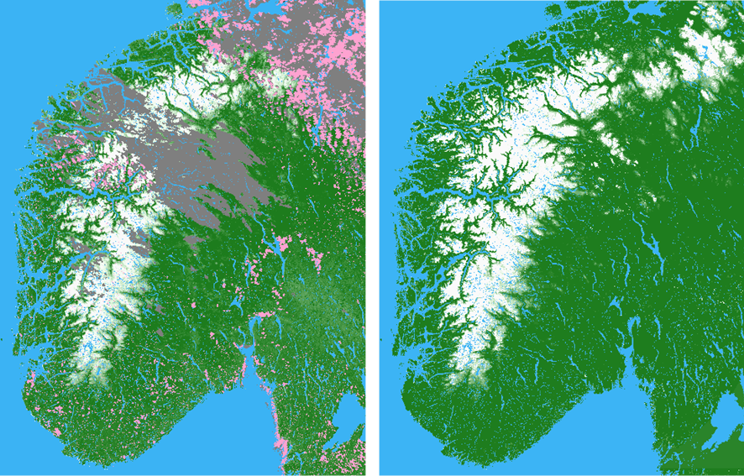
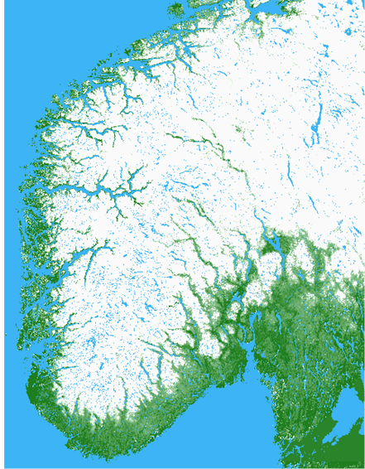
FSC from SLSTR, optical and multi-sensor multi-temporal
S&A optical
16 January 2017
27 March 2017
1 May 2017
27 May 2017
S&A multi

Slide 17
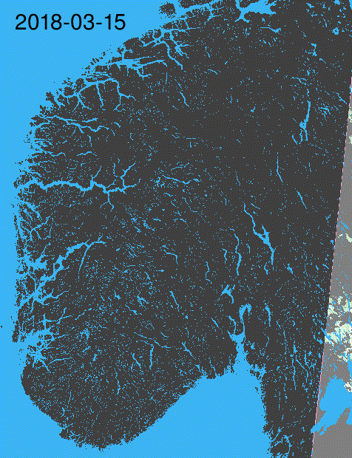
FSC from SLSTR, optical

Slide 18
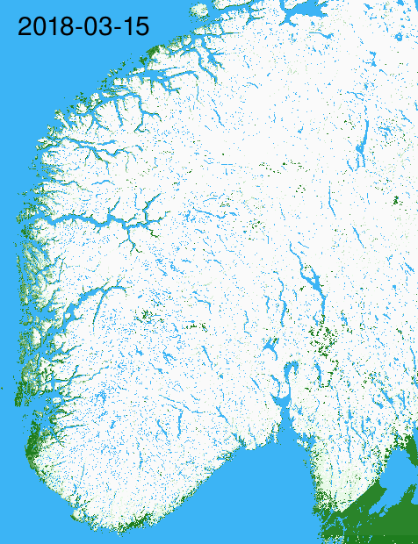
FSC from SLSTR, multi-sensor/multi-temporal

Slide 19
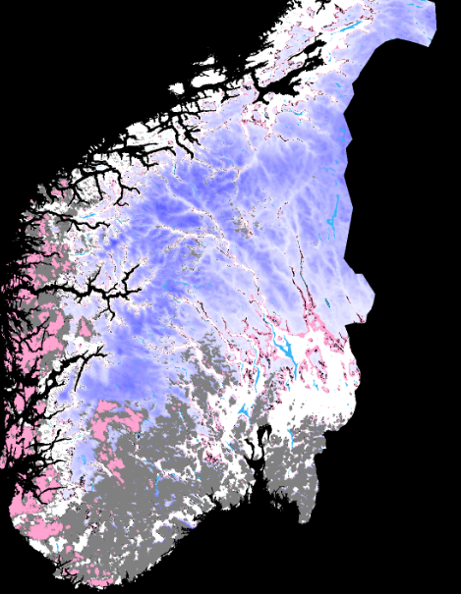
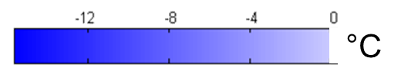
Snow surface temperature
The algorithm for snow skin surface temperature is based on an approach developed by Key et al. (1997):
Atmospheric attenuation of the snow surface brightness temperature is compensated for by combining bands differently affected by water vapour (split window) and view angle (path length through the atmosphere)
The algorithm requires surface emissivity. Therefore, we restrict retrieval to full snow cover
Coefficients for SLSTR TBD by Key, we use MODIS coefficients currently
Field measurements for MODIS indicate ̴ 0.5 °C accuracy
STS, SLSTR,11 April 2019

Slide 20

STS from SLSTR and MODIS
MODIS
23 February 2017
23 March 2017
1 May 2017
23 May 2017
SLSTR
°C

Slide 21
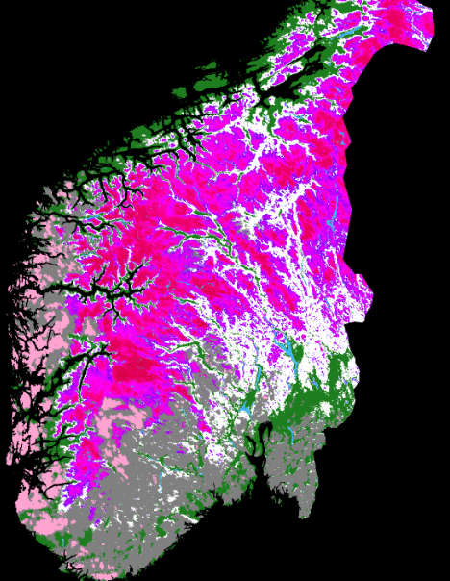
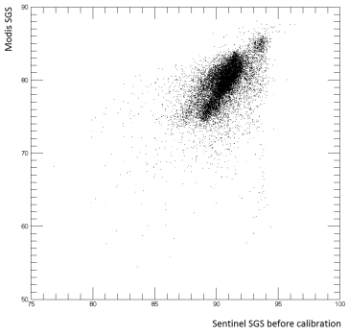
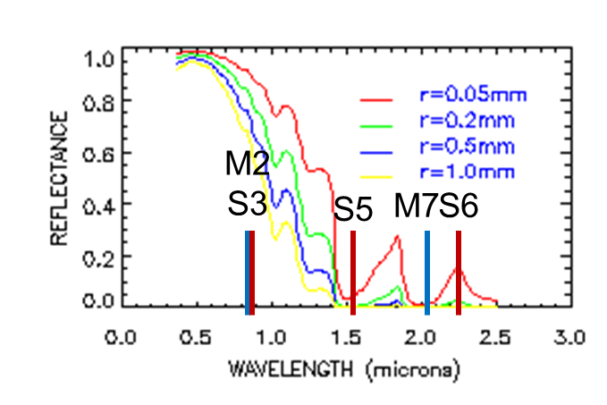

Snow grain size
Grain size index (Dozier 1989) based on the property that snow reflectance is sensitive to grain size in NIR
Represents the optical effective grain size
Strongly correlated with the geometrical grain size, but also depending on snow crystal shape
Only computed for fully snow-covered areas to avoid ground surface attenuation
TM: R47
MODIS: M27
SLSTR: S35
SGS, SLSTR,11 April 2019

Slide 22
SGS from SLSTR and MODIS
MODIS
23 February 2017
23 March 2017
1 May 2017
23 May 2017
SLSTR

Slide 23
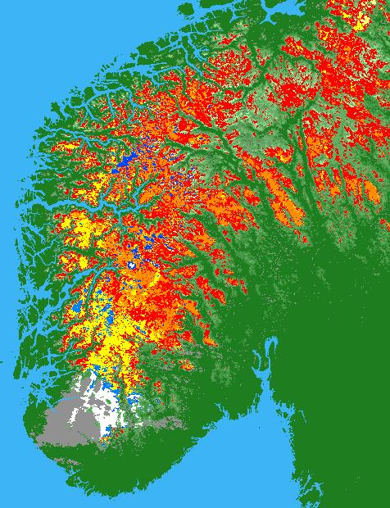



Snow Surface Wetness
Field measured snow temperature, and satellite-measured snow temperature and effective snow grain size for Heimdalen test site in 2003. HH = Heimdalshø, VF = Valdresflya
16 April 2003
20 April 2003
█ White - dry, cold snow: STS < -2°C.
█ █ Light/dark blue - dry/moist: -2°C < STS and -0.5°C
█ █ Yellow/orange - moist: -0.5°C < STS +0.5°C.
█ Red - wet: +0.5°C < +1.0°C
█ & █ Unchanged SGS. █ & █ Increasing SGS
Decision-tree algorithm
Wet snow metamorphism

Slide 24

SSW from SLSTR and MODIS
MODIS
23 February 2017
26 March 2017
28 March 2017
18 April 2017
SLSTR

Slide 25




Multi-sensor wet snow mapping – optical + SAR
Jotunheimen: Multi-sensor wet snow map for 16 June 2015 (left), optical wet snow map for the same day (middle) and SAR wet snow map for 17 June 2015 (right).

Slide 26





MWS from SLSTR + S-1 and MODIS + S-1
MODIS + Sentinel-1 SAR
13 February 2017
26 March 2017
30 April 2017
SLSTR + Sentinel-1 SAR

Slide 27





Snow surface hoar
Developing retrial model for snow surface hoar
14 occasions of in-situ observations of surface hoar reported to the project in winters 2018-2019
6 field excursions for measurements to sites with surface hoar carried out in winters 2018-2019
Reports to the national database (NVE) still to be searched through (typically 10-20 reports per winter)
(Picture source: ASARC, Univ. of Calgary)
7 February 2013
8 February 2013
9 February 2013
Terra MODIS

Slide 28


Summary and conclusions
Retrieval algorithms developed for MODIS over a 15-years period:
  Snow cover
  Snow surface temperature
  Snow grain size
  Snow surface wetness
  Snow surface hoar
Now being ported to Sentinel-3 SLSTR and OLCI and improved, tested, validated and demonstrated
Multi-sensor algorithms developed when synergy between sensors can be obtained (like Sentinel-1 + Sentinel-3)
A new generation of distributed hydrological models are more closely modelling the physical reality. Expected to benefit from input from earth observation

