Slide 1


EUMETSAT’s Network
of Satellite Application Facilities
Lothar Schüller
SAF Network Manager
EUMETSAT

Slide 2

SAF concept
SAF = Satellite Application Facility
part of the EUMETSAT application ground segment
providing operational products and services to users
specialised on topics and themes
complement production of standard meteorological products at EUMETSAT Secretariat
located at Weather Services in EUMETSAT Member and Co-operating States
developed and operated by consortium of partners
Satellite
Application
Facilities
SAFs

Slide 3
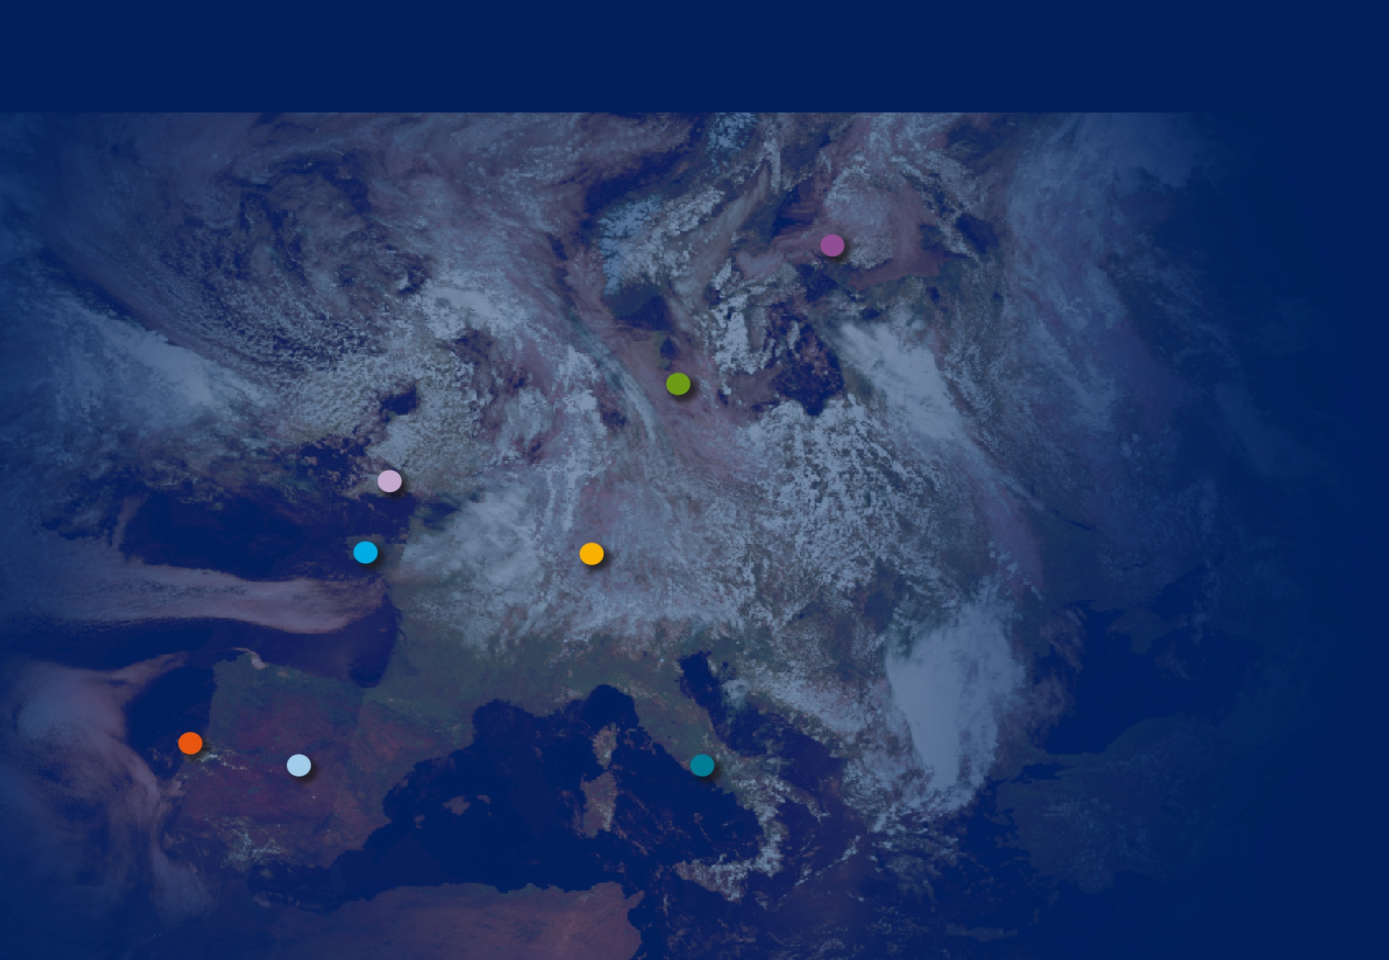
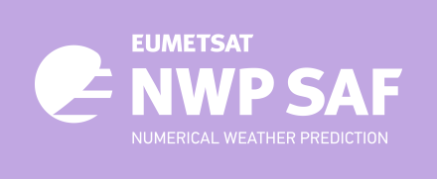








EUMETSAT Network of Satellite Application Facilities

Slide 4

Nature of operational satellite products
The goal of SAFs is to provide operational products.
Continuity of product provision
Continuity of product improvements
Continuity of quality monitoring
Committed user services /
Validation and review before official release/launch
Complete Documentation of Products, Algorithms, Validation Results
...

Slide 5
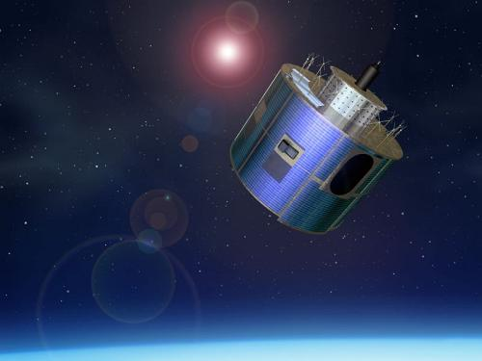
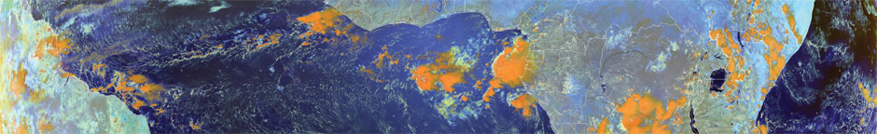
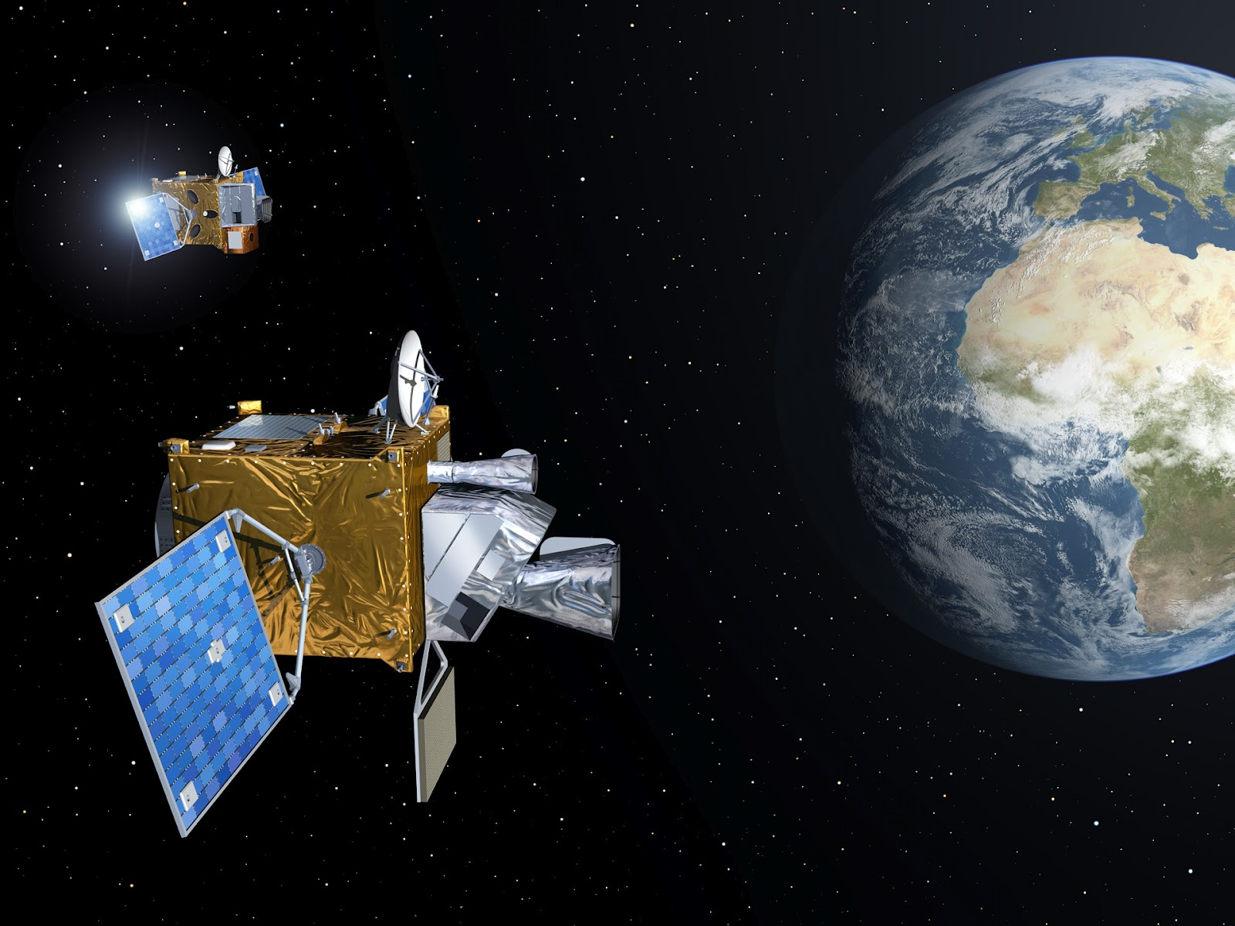
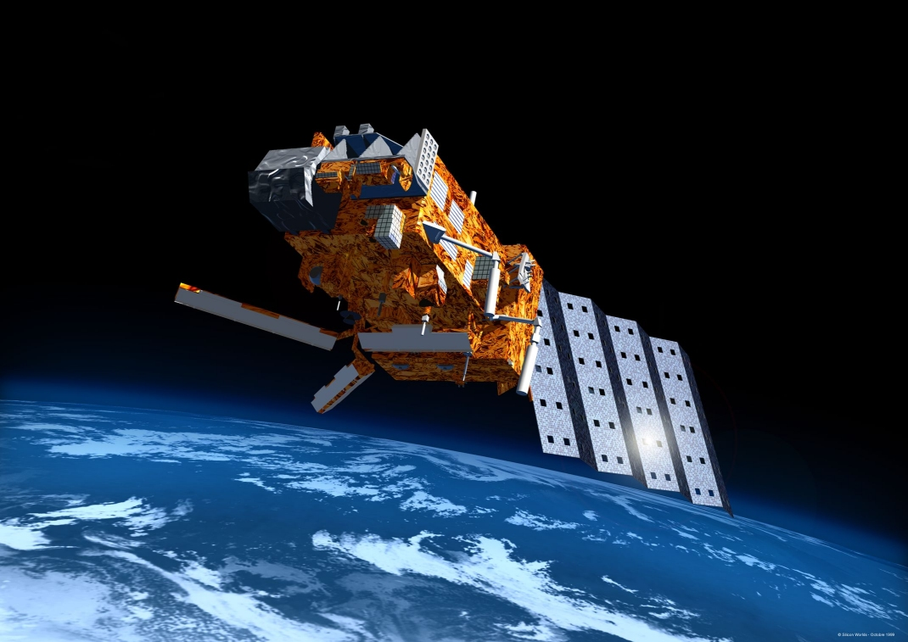
35 years of SAF Development and Operations
 | 1997 |  | 1998 |  | 1999 |  | 2000 |  | 2001 |  | 2002 |  | 2003 |  | 2004 |  | 2005 |  | 2006 |  | 2007 |  | 2008 |  | 2009 |  | 2010 |  | 2011 |  | 2012 |  | 2013 |  | 2014 |  | 2015 |  | 2016 |  | 2017 |  | 2018 |  | 2019 |  | 2020 |  | 2021 |  | 2022 |  | 2023 |  | 2024 |  | 2025 |  | 2026 |  | 2027 |  | 2028 |  | 2029 |  | 2030 |  | 2031 |  | 2032
MSG |  |  |  |  |  |  |  |  |  |  |  |  |  |  |  |  |  |  |  |  | EPS |  |  |  |  |  |  |  |  |  | MTG |  |  |  |  |  |  |  |  |  |  |  |  |  |  |  |  |  |  |  |  | EPS-SG
Development / Initial Operations Phases |  |  |  |  |  |  |  |  |  |  |  |  |  |  |  |  |  |  |  |  | Continuous Development and Operations Phase CDOP 1 |  |  |  |  |  |  |  |  |  | Continuous Development and Operations Phase CDOP 2 |  |  |  |  |  |  |  |  |  | Continuous Development and Operations Phase CDOP 3 |  |  |  |  |  |  |  |  |  |  | Continuous Development and Operations Phase CDOP 4 |  |  |  |  |  |  |  |  |  | Continuous Development and Operations Phase CDOP 5
NWC SAF
OSI SAF
O3M SAF
AC SAF
NWP SAF
CM SAF
GRAS SAF
ROM SAF
LSA SAF
H SAF

Slide 6

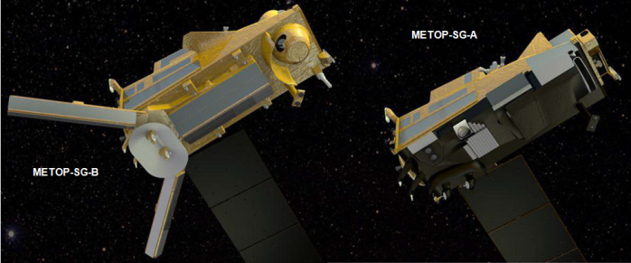


SAF Network and the EUMETSAT Programmes
SAFs embedded financially in EUMETSAT Mandatory Programmes beginning with Meteosat 2nd Generation and continued with EUMETSAT Polar Systems EPS (Metop satellites).
Within the new generation programmes MTG and EPS-SG, SAFs have assigned responsibilities for Day 1 products (continuity).
Success of Programmes and operational status of satellites depend also on SAF developments
Next Phase CDOP 4 (2022-2027) targets Day-1 services plus the full exploitation of the new sensors capabilities

Slide 7

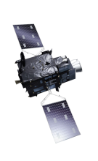
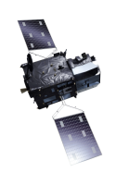
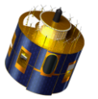

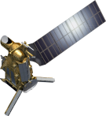
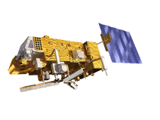
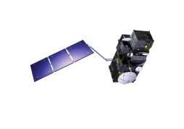
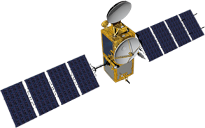

EUMETSAT missions – current and future
Geostationary
Programmes
MSG-4 / Meteosat-11
In-Orbit Storage 2016
Prime Satellite 2018
MTG-I
Imagery
2021
MTG-S
Sounding
2023
Meteosat-10
2013
Meteosat-9
2006
Mandatory
Programmes
Meteosat-8
2004
Polar
Programmes
Metop-A
2007
Metop-B
2013
Metop-C
2019
Metop-SG A
Sounding & Imagery
2022
Metop-SG B
Microwave Imagery
2023
Optional and
Third Party
Programmes
(incl. Copernicus)
JASON-2
2009
Sentinel-3A
2016
JASON-3
2016
Sentinel-3B
2018
JASON-CS/
SENTINEL-6 “Mike Freilich”
2021
Sentinel-5
on Metop-SG A
2022
Sentinel-4
on MTG-S
2023
Notes:
Alternative design to slide 7, without the years/timeline

Slide 8

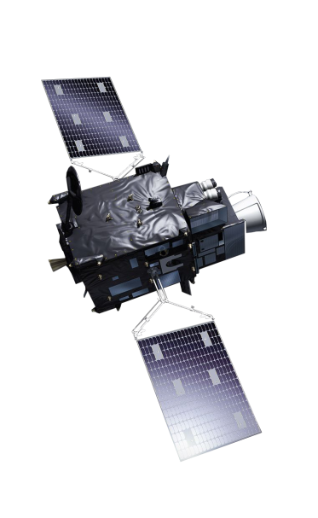
Meteosat Third Generation: Imaging mission (MTG-I)
Flexible Combined Imager (FCI) - Imagery mission implemented by two MTG-I satellites
Full disc imagery every 10 minutes in 16 bands
Fast imagery of Europe every 2.5 minutes
New Lightning Imager (LI)
Start of operations in 2022
Operational exploitation:
2022-2042

Slide 9
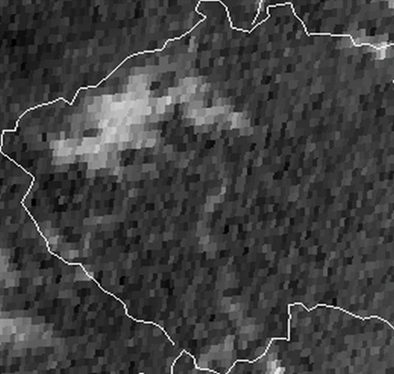
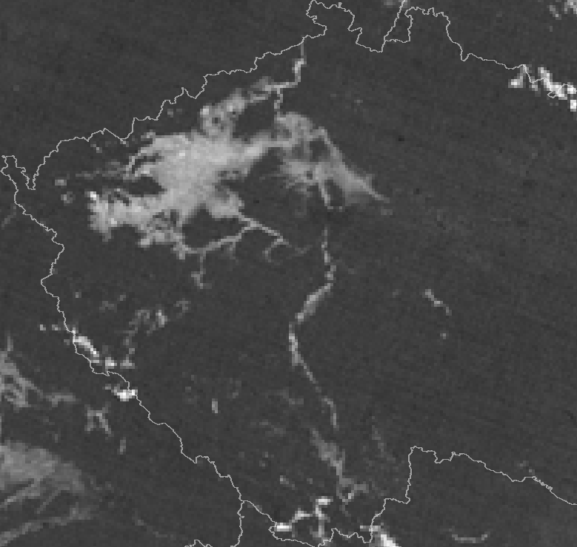
MTG Imager (FCI): higher spatial resolution imagery
Current
Future
Example of fog detection over Czech Republic
Source: M. Setvak, J. Kerkmann; 16 Nov 2018, 01.37 UTC
Right panel: simulated FCI imagery at ~2 km horizontal resolution
(1 km at nadir), based on NOAA Suomi-NPP VIIRS data
Left panel: MSG SEVIRI imagery at 5 km horizontal resolution (3 km at nadir)

Slide 10
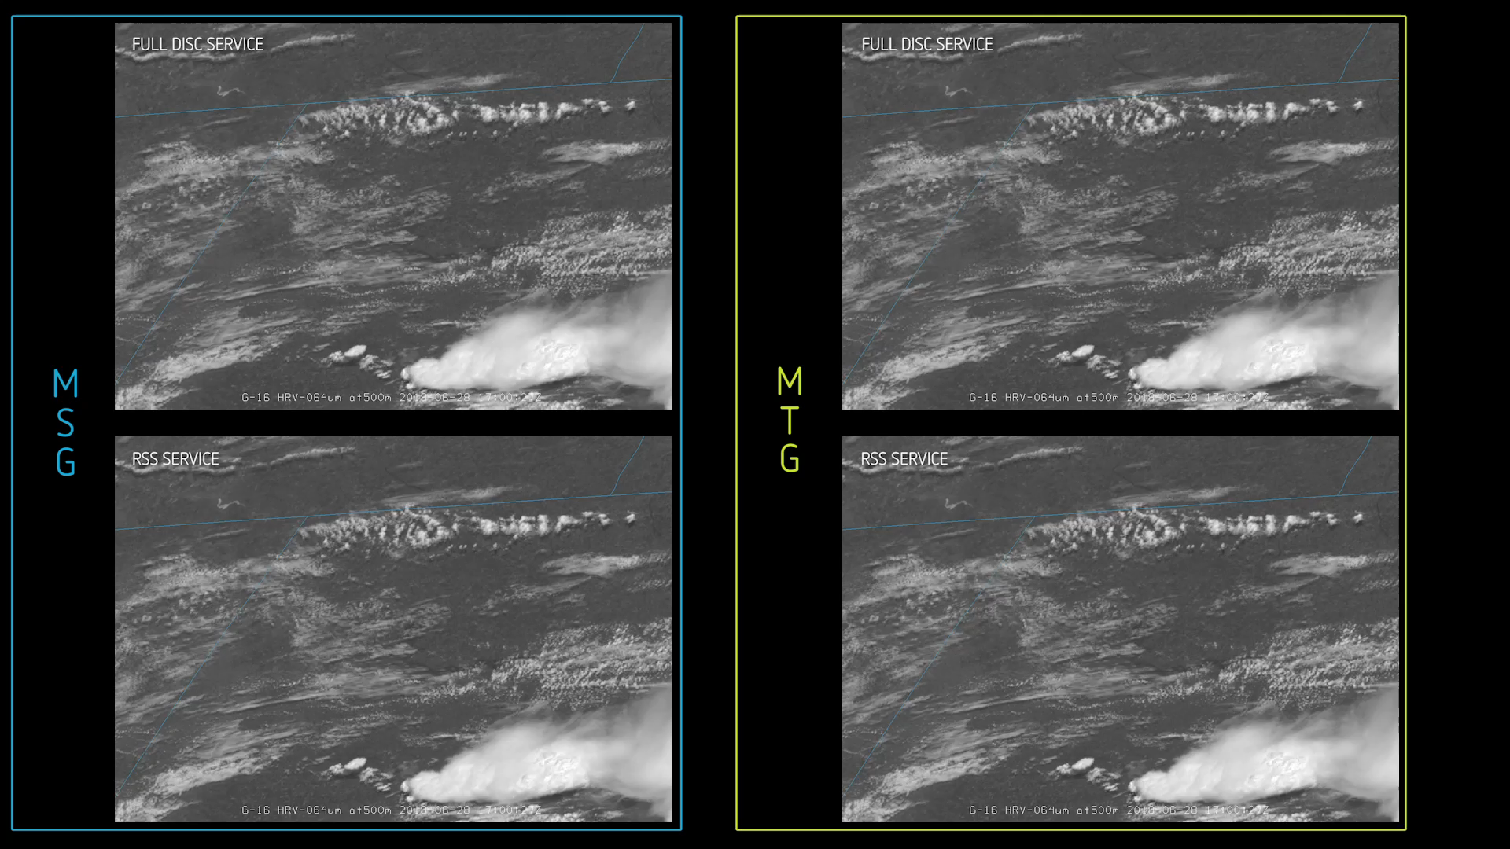
MTG Imager (FCI):
New insights through higher temporal resolution
15 min
10 min
5 min
2.5 min
Current
Future

Slide 11

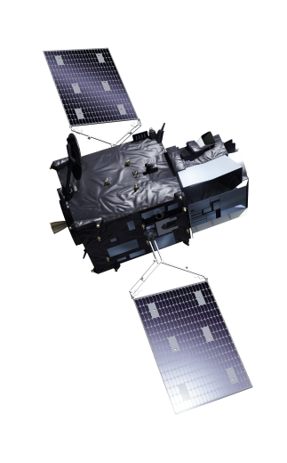
MTG Full Operational Configuration
MTG-I in Rapid Scan Service on EUMETSAT member states
MTG-I in Full Scan Service
MTG-S Sounding Service

Slide 12
MTG Data Products – Level 2 Geophysical products from SAFs
Product | SAF
Precipitation rate at ground by GEO/IR supported by LEO/MW and MTG FCI | Hydrology SAF
Accumulated precipitation at ground by blended MW+IR and MTG FCI - Daily | Hydrology SAF
Accumulated precipitation at ground by blended MW+IR and MTG FCI - Hourly | Hydrology SAF
Hydrology SAF – Snow detection and coverage | Hydrology SAF
Hydrology SAF – Rainfall intensity from MTG LI | Hydrology SAF
Surface Albedo | Land SAF
Land Surface Temperature | Land SAF
Product | SAF
Downward Longwave Irradiance combined with the Solar Surface Irradiance - Daily | Ocean and Sea Ice SAF
Downward Longwave Irradiance combined with the Solar Surface Irradiance - Hourly | Ocean and Sea Ice SAF
Sea Surface Temperature | Ocean and Sea Ice SAF
4 products on clouds 4 precipitation products 1 clear-air product (profiles) 2 winds products 2 convection products | NWC SAF (software)

Slide 13
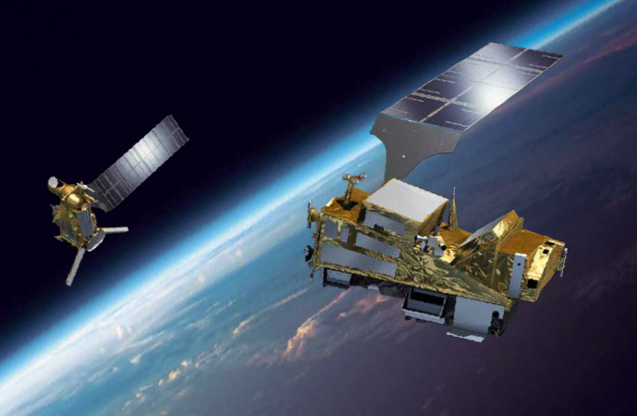
The next generation of Polar Orbiting Satellites: Metop-SG

Slide 14
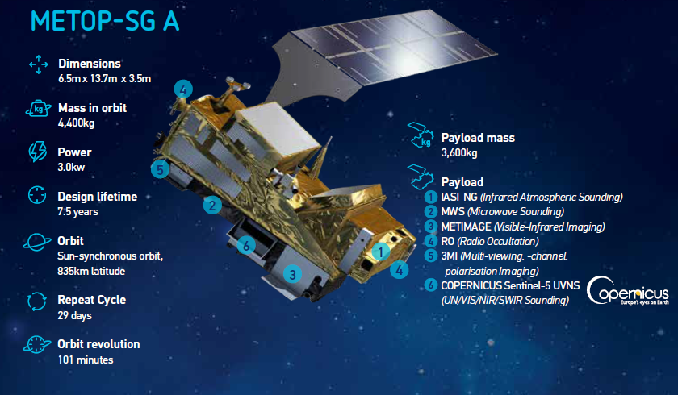
Planned launch dates: Q1 2023 2029 2036

Slide 15
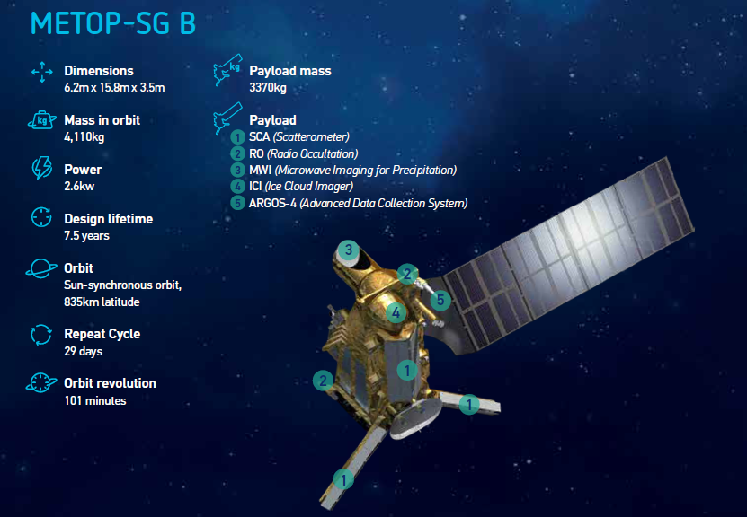
Planned launch dates:
Q4 2023
2030
2037

Slide 16
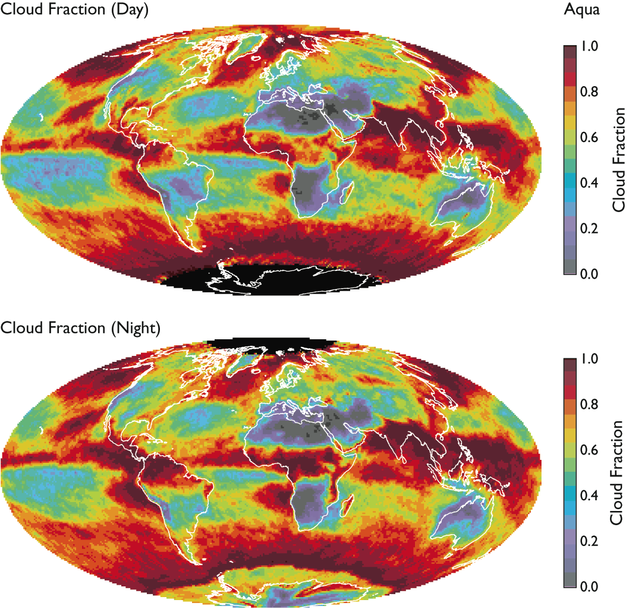
Metop-SG Optical imaging (METimage)
Objectives / products
Hi-res cloud products, incl. microphysics
Aerosols
Polar AMVs
Vegetation, snow, fire
Sea/ice/land surface temperature
Support to sounding missions
Key performances
20 channels: 0.443 – 13.345 µm
Absolute calibration: 5% (short-wave)
0.5 K (long-wave)
Radiometric sensitivity:
SNR 60 – 500 (short-wave)
0.05 – 0.3 K (long-wave)
Spatial sampling: 500 m
Cross-track scan
Applications benefitting
Nowcasting
Numerical weather prediction
Oceanography
Hydrology
Climate monitoring
Land surface analysis
Breakthrough
Far more spectral channels than AVHRR for the benefit of measuring more variables
Higher spatial sampling (500 m):
    more complete coverage through greater likelihood to measure surface variables in partly cloud conditions
Better radiometric resolution for more accurate quantification of many variables

Slide 17
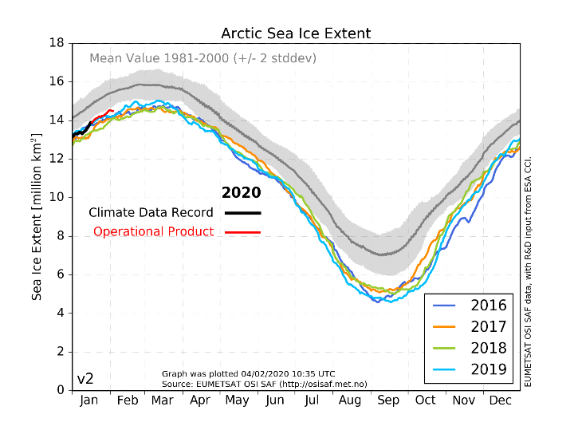
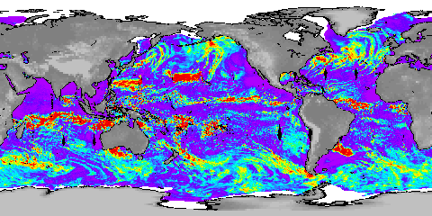
Metop-SG Micro-wave imaging (MWI)
Objectives / products
Precipitation and cloud products
Water vapour imagery
Sea-ice, snow, sea surface wind
Key performances
18 channels: 18.7 – 183 GHz
Dual polarisation (V, H) up to 89 GHz
V polarisation at higher frequencies
Radiometric accuracy: 1 K
Radiometric sensitivity: 0.6 – 1.2 K
Footprint size: 10 – 50 km
Spatial sampling: 7 km
Conical scan
Applications benefitting
Numerical weather prediction
Nowcasting
Oceanography
Hydrology
Climate monitoring
Cloud Liquid Column
mm
Breakthrough: 18 channels
Continuity of key microwave imager channels for weather forecast
Inclusion of dedicated sounding channels (118.75 GHz)
  Enhanced precipitation measurements through inclusion of dedicated sounding channels
Extended suite of 183.31 GHz channels
  water-vapour and cloud profiling

Slide 18
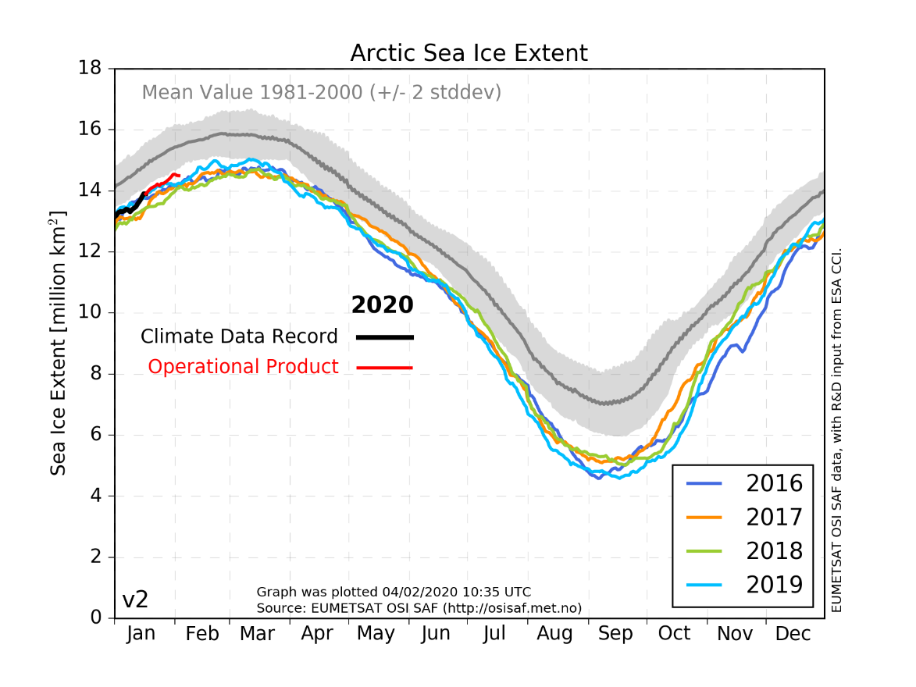
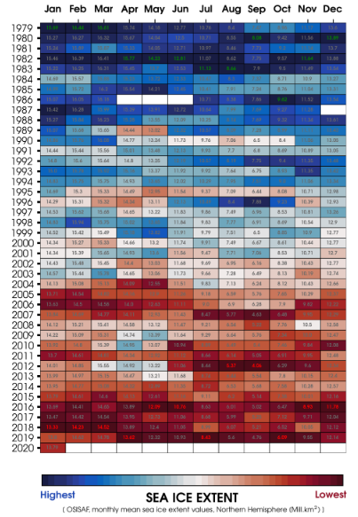
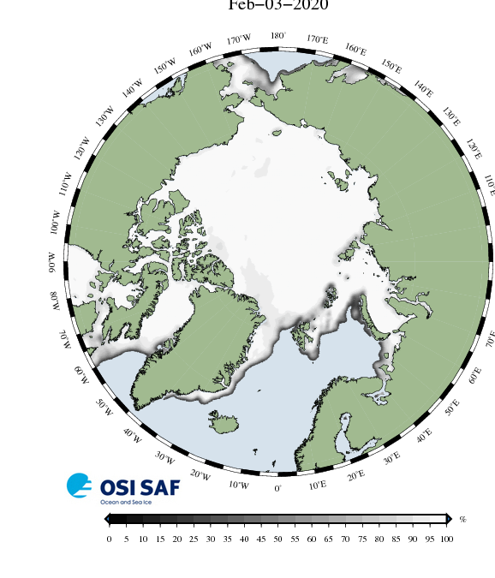
Monitor what is vanishing: Sea Ice Extend

Slide 19
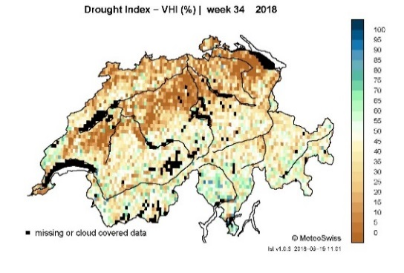
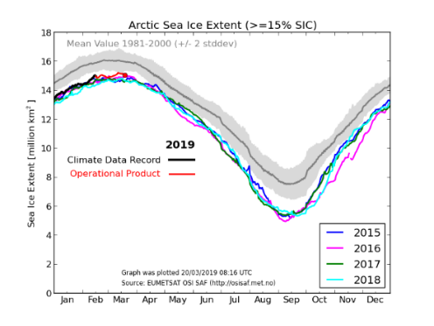
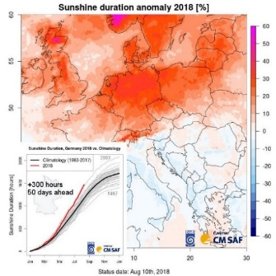
Anticipated headlines for SAF CDOP 4 (2022-2027)
SAFs and new programmes MTG and EPS-SG:
  Implementation of Day 1 products for MTG and EPS-SG to ensure continuity
  Full exploitation of new capabilities of MTG and EPS-SG (Day 2 products)
  Facilitate the preparation of applications and users for the era of new generation missions
Priority to needs and requirements of member states
  Nowcasting and NWP as the core activities of national meteorological services
  Bridging the gap between satellite data and non remote sensing experts gridded based indicators in addition to pixel based data, observational complement to model data, more directly fulfilling need of NMSs
Integrated approach
  multi-mission products, multi SAF products, cross-dependencies, Sat+In situ+Model, scientific consistency of products)
  Consistent continuation of long-term data records (CDR + ICDR) for anomaly detection
Existing SAF products:
  critical review of relevance and scientific excellence: Discontinuation of obsolete products
Integration within EUMETSAT and Europe
  Complementarity to Copernicus missions and services: particular focus on EUMETSAT sensors and satellites
  Integrating and interfacing with new data services (“big data challenge”) at EUMETSAT and European level
  Coordinated contribution to the overall EUMETSAT product portfolio. EUMETSAT roadmaps, shared and joined activities within the SAF network and EUMETSAT headquarters. Effective exploitation of lessons learned and synergies.

Slide 20
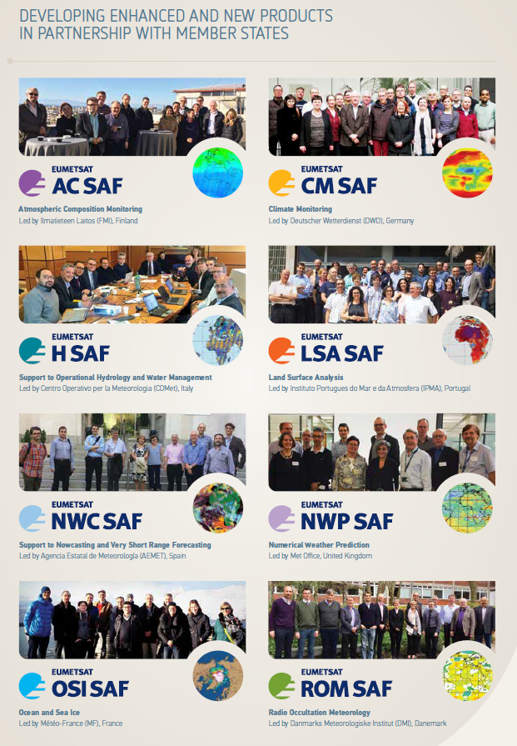
SAF activities for entering a new era
Develop the technical and scientific conditions: new processing chains and adapted algorithms
Priority No. 1: Ensure the continuity of their core products with Day-1
Exploit the new and improved observational capabilities for their services to users
Interact with their user communities to assess the requirements and priorities and to prepare them for the major upgrade
  Dedicated Training activities
  User Workshops
  Help desks
Propose product and service portfolio for the 2022-2027 timeframe (CDOP 4)

Slide 21
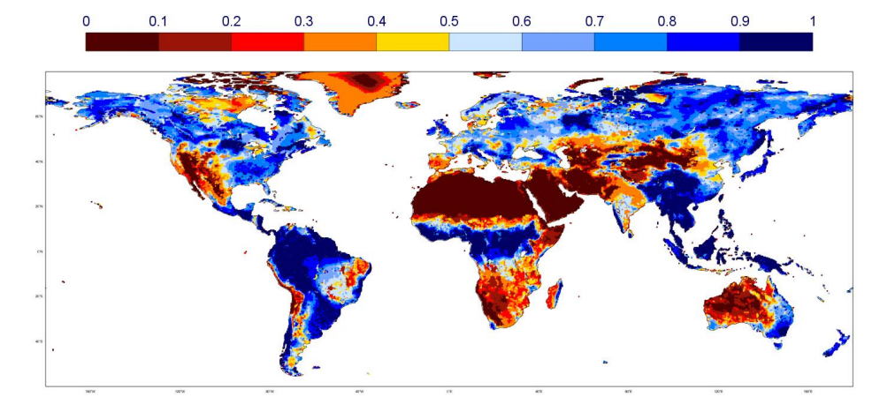
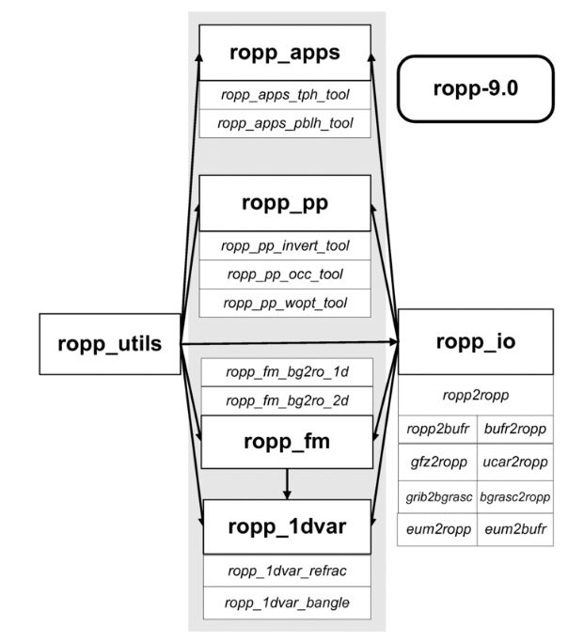
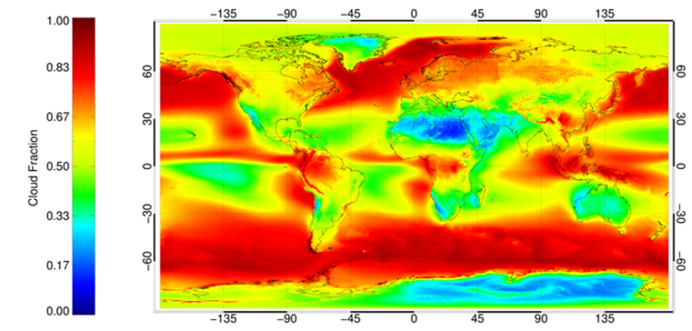
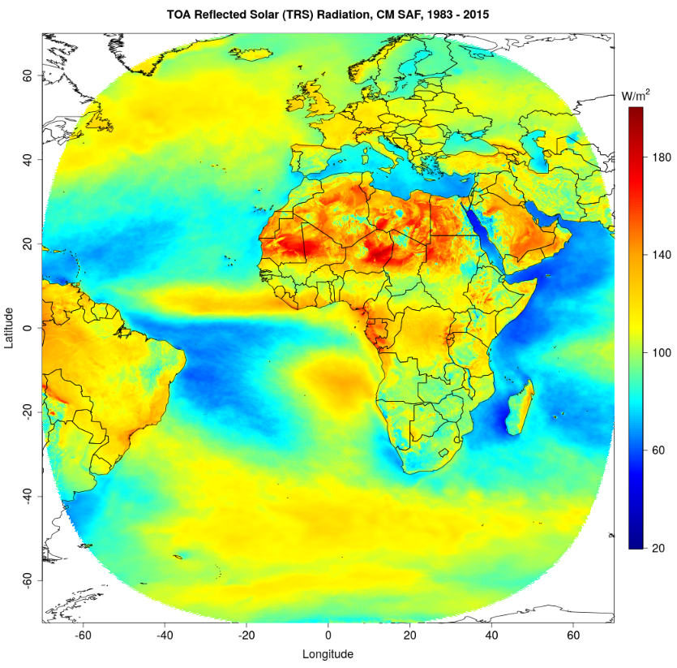






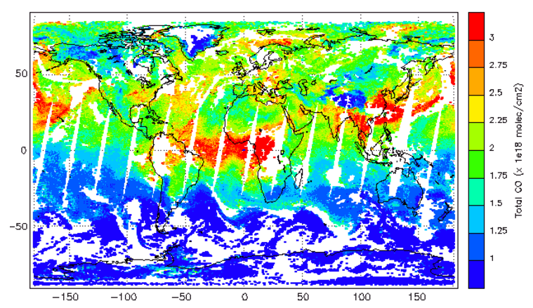
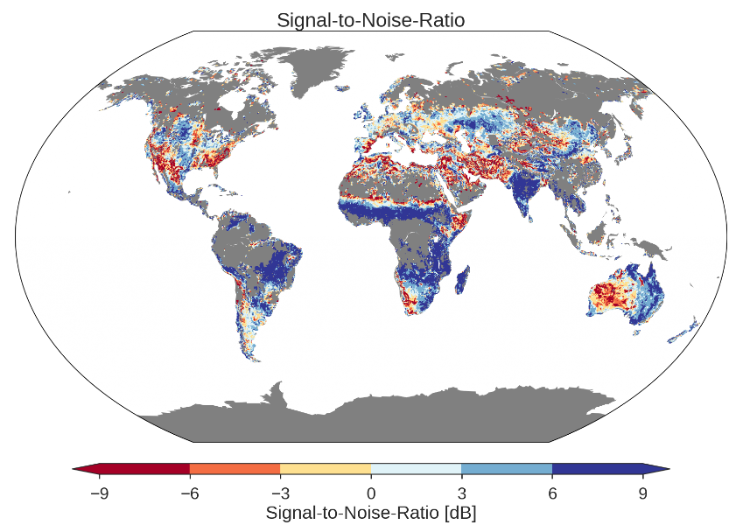
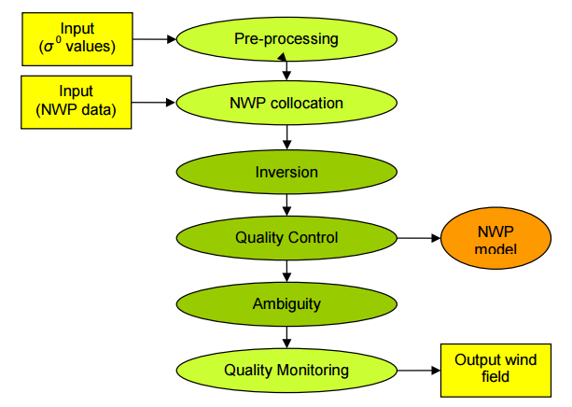
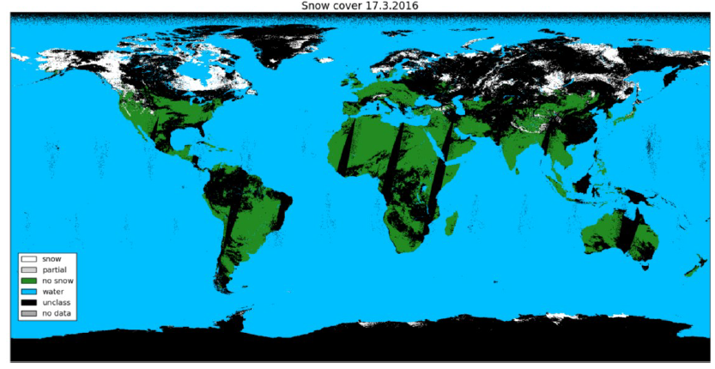





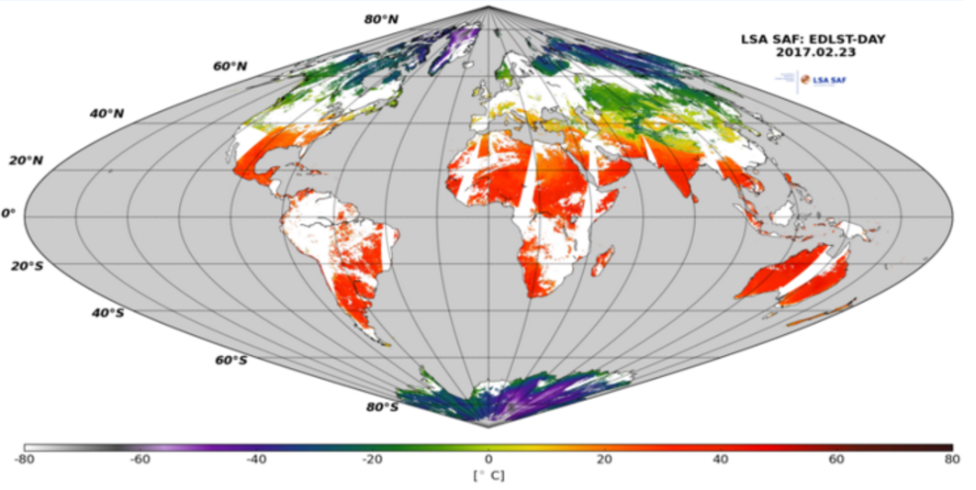
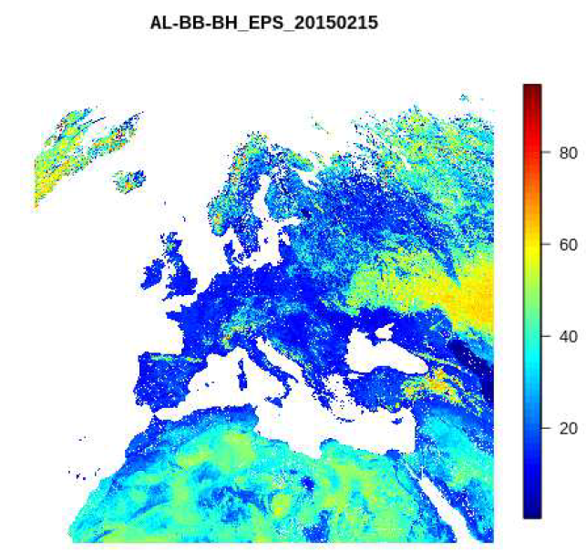
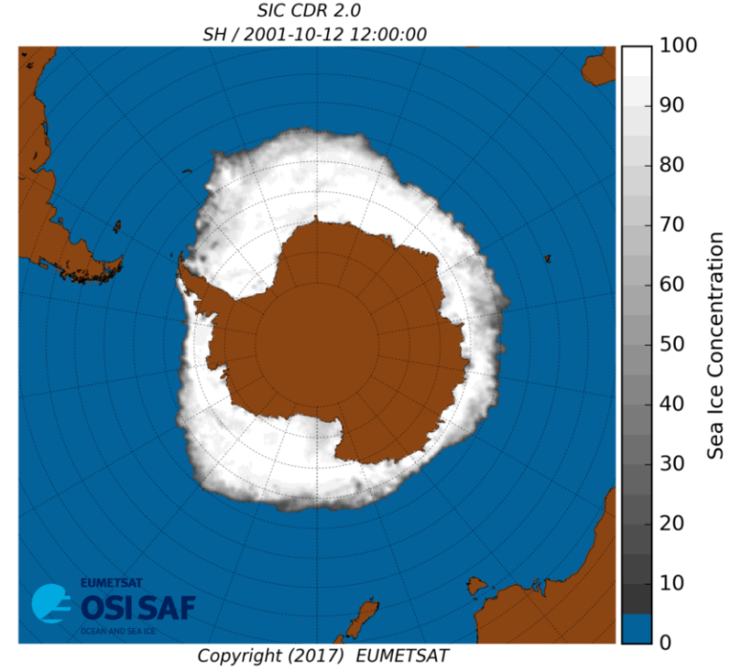
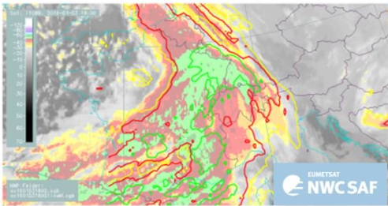

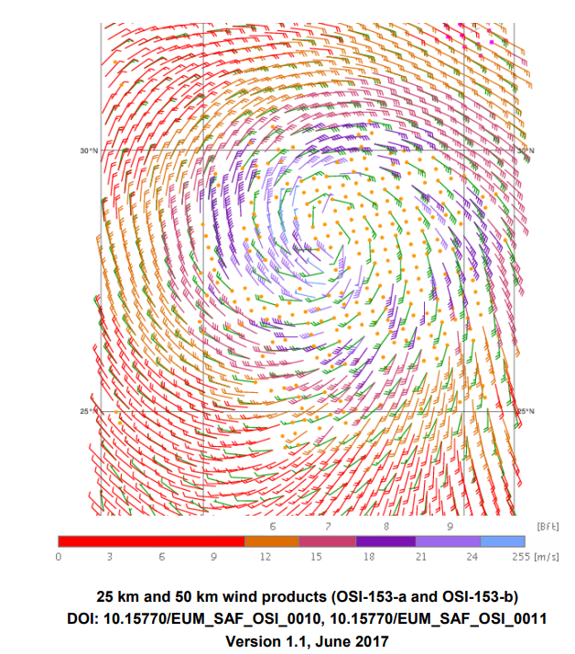
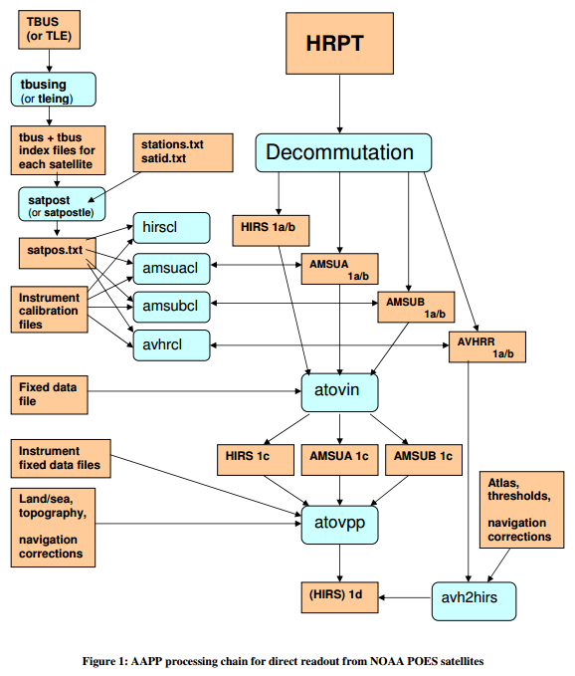

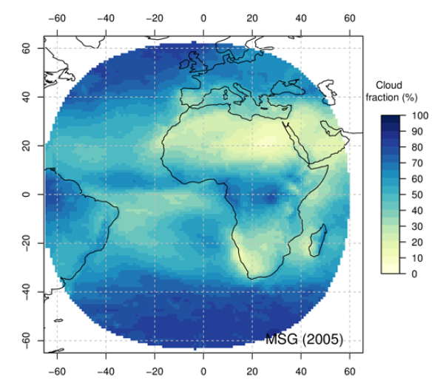
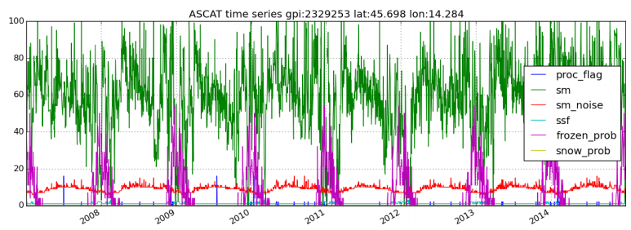
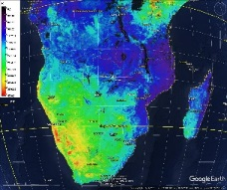
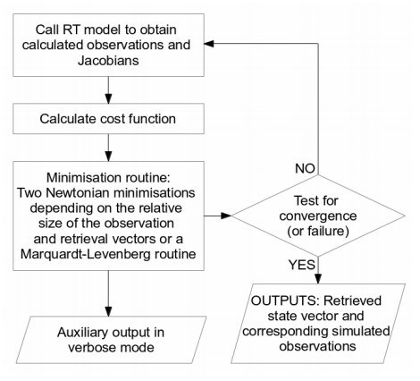




Connect to the SAFs
SAF Web pages:
http://www.eumetsat.int
http://h-saf.eumetsat.int
http://osi-saf.eumetsat.int http://nwc-saf.eumetsat.int etc….
Twitter: @LotharSchueller
@Climate_SAF
@OSISAF
@Nowcasting_SAF
@Atmospheric_SAF
@rom_saf
@LSA_SAF
@NWP_SAF
@HydroSAF

